Slide 1
ABUJA ELECTRICITY DISTRIBUTION COMPANY
DER OPPORTUNITIES
YOLA ELECTRICITY DISTRIBUTION COMPANY
CONTACT US
NO2, Atiku Abubakar Road, Jimeta-Yola, Adamawa State
09038853326/09038853342
info@yedc.com.ng
PRESENTATION

Slide 2
Company Profiles
Safety
Professionalism
Integrity
Respect
Innovation
Teamwork
Yola Electricity Distribution Company (YEDC) is the distribution company responsible for the distribution of energy to Adamawa, Taraba, Borno, and Yobe states of Nigeria. Formally privatized in November 1, 2013 but was handed back to Government. It was formally taken over by Quest Electricity Nigeria Limited on 1st January 2022.

Slide 3
11kV ABTI FEEDER

Slide 4
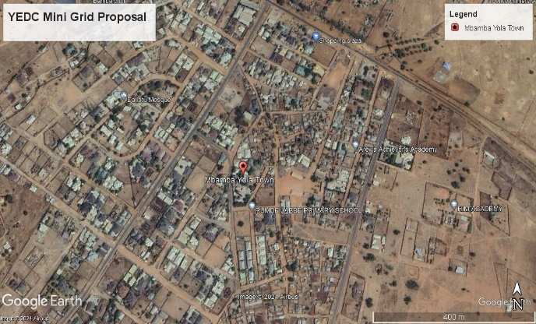
Overview of Cluster
S/N | DESCRIPTION | VALUE
1. | Average Hours of Supply | 10 Hours
2. | Number of Connections | 4,000
3 | Estimated Customer Population | 7,000
4. | ATC&C Loss | 15%
5. | Metering Penetration | 100%
6. | Average Monthly Collections | N8,000,000
REGION: Adamawa
BUSINESS UNIT: Yelwa
LOCATION: Mbamba Yola Town
ESTIMATED LOAD DEMAND: 1.0MW
DISTRIBUTION INVESTMENT REQUIREMENT: NOT SPECIFY
95%
5%
RESIDENTIAL
COMMERCIAL & INDUSTRIAL

Slide 5
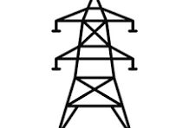
Infrastructure
FAIR
STATE OF NETWORK
Top 3 Economic Activities
Water factories
Shops
3. Rice mill
GOOD
ROAD ACCESSIBILITY
Feeder Route Length
13.5km
Voltage Level
11KV
Daily Load Profile
1.5
Installed Transformer Capacity
2X500KVA
GOOD
SECURITY STATUS
Network Limitations
Business Model
Interconnected Mini-Grid
Yes
PIP FOCUSED AREA
Developing area/insufficient number of DTs./Rehabilitation of LT needed/Technical (poor voltage Profile)

Slide 6
33kV BIU
FEEDER

Slide 7
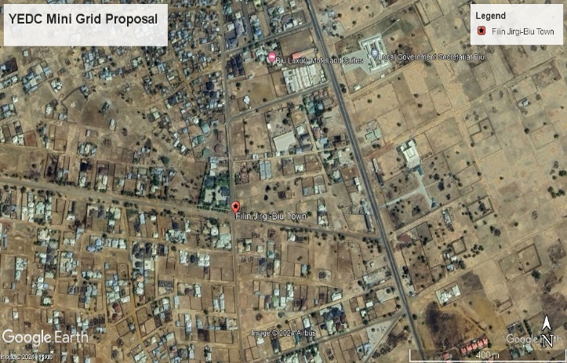
Overview of Cluster
S/N | DESCRIPTION | VALUE
1. | Average Hours of Supply | 16 Hours
2. | Number of Connections | 550
4. | Estimated Customer Population | 700
5. | ATC&C Loss | 60%
6. | Metering Penetration | 70%
REGION: Borno
BUSINESS UNIT: Biu
LOCATION: Biu Town
ESTIMATED LOAD DEMAND: 0.8MW
80%
20 %
RESIDENTIAL
COMMERCIAL & INDUSTRIAL

Slide 8
Infrastructure
FAIR
STATE OF NETWORK
Top 3 Economic Activities
Residential
2. Commercials
GOOD
ROAD ACCESSIBILITY
Feeder Route Length
14.4km
Voltage Level
33kV
Daily Load Profile
0.8
Installed Transformer Capacity
1X500KVA
GOOD
SECURITY STATUS
Network Limitations
Business Model
Interconnected Mini-Grid
Rehabilitation of HT/LT needed/Technical (poor voltage Profile)
Yes
PIP FOCUSED AREA

Slide 9
11kV TAKUM TOWN
FEEDER

Slide 10
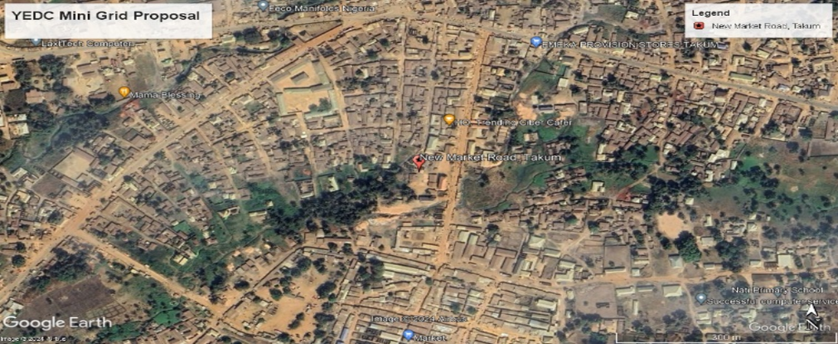
Overview of Cluster
S/N | DESCRIPTION | VALUE
1. | Average Hours of Supply | 12 Hours
2. | Number of Connections | 1,696
4. | Estimated Customer Population | 3,906
5. | ATC&C Loss | 45%
6. | Metering Penetration | 2%
7. | Average Monthly Collections | N350,000
REGION: Taraba
BUSINESS UNIT: Wukari
LOCATION: New Market Road, Takum
ESTIMATED LOAD DEMAND: 1.0MW
DISTRIBUTION INVESTMENT REQUIREMENT: NOT SPECIFY
40 %
60 %
RESIDENTIAL
COMMERCIAL & INDUSTRIAL

Slide 11
Infrastructure
FAIR
STATE OF NETWORK
Top 3 Economic Activities
Millers
2. Residential
GOOD
ROAD ACCESSIBILITY
Feeder Route Length
13.7km
Voltage Level
11KV
Daily Load Profile
1
Installed Transformer Capacity
1X500KVA
GOOD
SECURITY STATUS
Network Limitations
Business Model
Interconnected Mini-Grid
Yes
PIP FOCUSED AREA
Rehabilitation of LT needed/Technical (poor voltage Profile)

Slide 12
Summary of YEDC DER Pipeline
S/N | Project | Estimated Load Demand (MW) | Number of Connections | Average Monthly Collections (NGN) | Distribution Investment Required (NGN) | Installed Distribition Transformer Capacity (kVA) | Proposed Business Model
1 | 11kV ABTI FEEDER | 1MW | 4,000 | N8,000,000 | million | 2X500 | Interconnected mini-Grid
2 | 33kV Biu Town | 0.8MW | 550
3 | 11kV Takum

Slide 13
THANK
YOU

