Slide 1
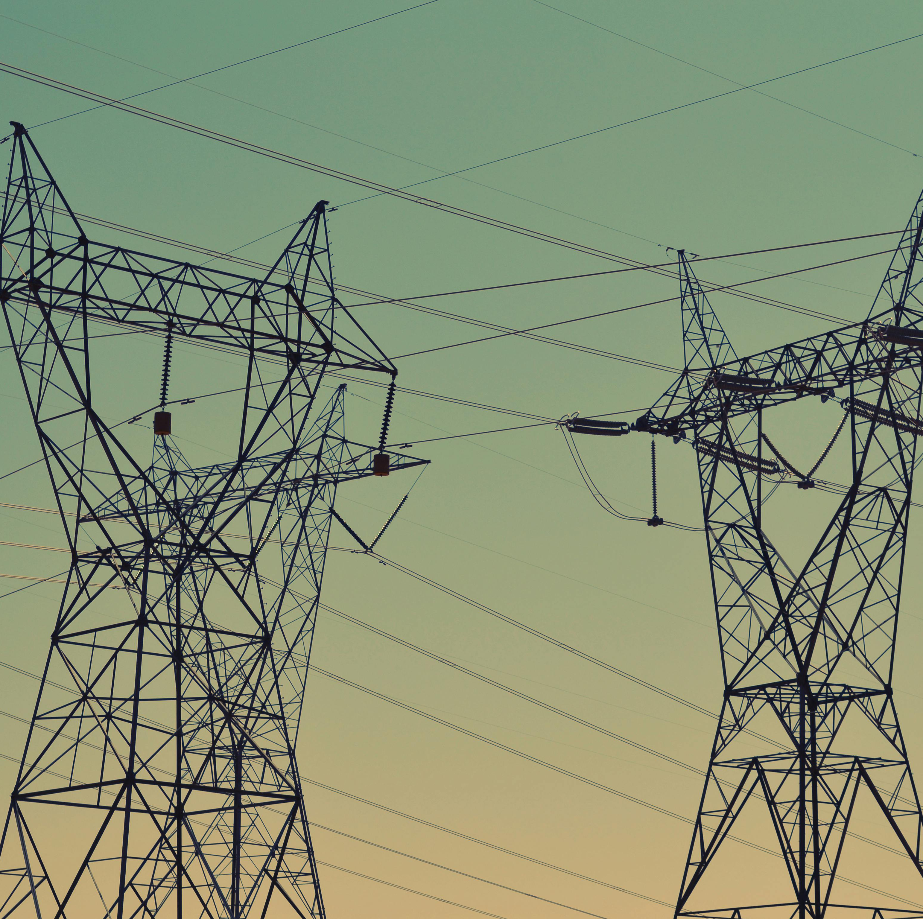
DER OPPORTUNITIES
PORT HARCOURT ELECTRICITY
DISTRIBUTION COMPANY

Slide 2
ABOUT PHED – OUR VISION AND MISSION
Vision
Core Values
Vision
To be the No. 1 Electricity
Distribution Company within our chosen market.
Mission
We supply quality and reliable
power safely, to our valued customers, to ignite socio-economic growth, while relying on our highly Innovative and motivated workforce.
Vision
&
Mission
Mission
-25
TRICE
Teamwork
Reliability
Integrity
Customer Service
Excellence

Slide 3
About PHED – Key Facts
Key Statistics | PHED OVERVIEW
Core Business | Distribution of electricity in Akwa-Ibom, Bayelsa, Cross River and Rivers States.
Operating Regions | 11 Regions (1 – Bayelsa, 6 – Rivers, 2- Akwa-Ibom, 2 – Cross River)
Total Service Area | 49,087 sq Km
Average Customer (Active/Inactive) Population | 725,058
Staff Strength | 2,466
Unbundling to PHED: 2013
Main Shareholder: 4Power Consortium Ltd
Transmission Station: 16
Load Capacity: 2,716,534MW/Year
MYTO Allocation of Energy: 6.5%
Actual Energy Offtake: 7%

Slide 4
About PHED – Activity Overview
We manage the distribution of Power for voltages between 33kV to 0.220kV.
We cover 4 states and operate through 11 Regions and 2 Sub-regions.
Our revenue cycle – 60 days – starts from input energy, billing, and Collection.
Within this cycle activities such as Network maintenance – preventive and breakdown maintenance are carried out.
We also actively resolve customer complaints as a key part of our operations.
Business expansion into underserved and unserved areas within our network with reference to our performance improvement plan.
Meter deployment across the Franchise through Meter Access Provider (MAP) Scheme and Disco financed metering schemes.
Ogoja Sub-Region
Calabar
Ahoada Sub-Region
Eket Region
Alpha 1
Ikot Ekpene Region
Alpha 2
Beta 1
Bayelsa
Uyo Region
Beta 2
Gamma 1
Gamma 2

Slide 5
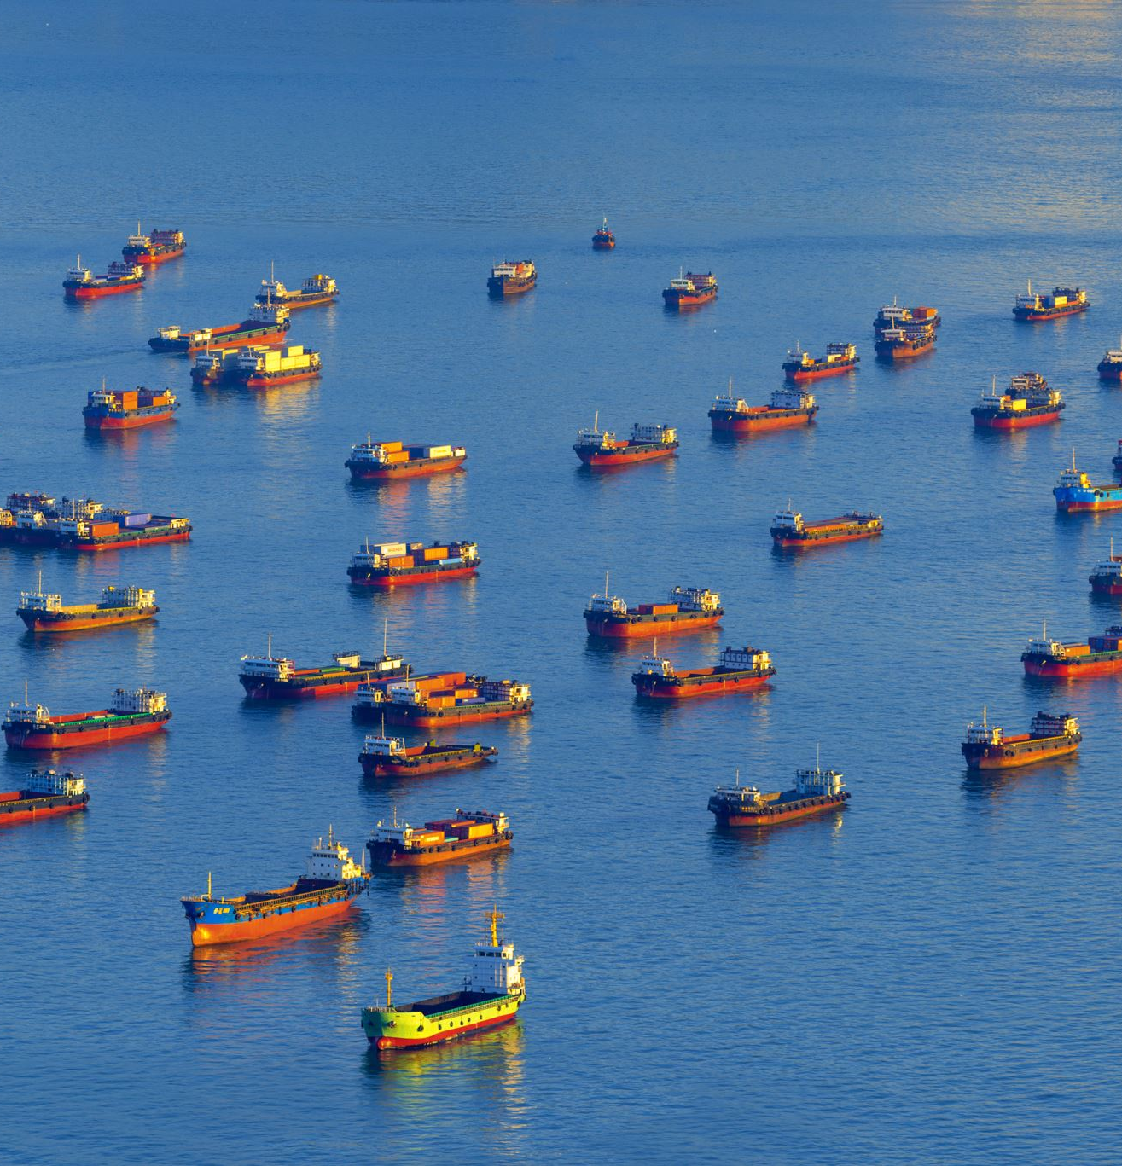
EKET REGION
Economic Opportunities: Ibaka in the Eket region is a high-potential commercial environment, particularly because of its strategic location. It is home to a mini sea-port and a naval base, both of which are critical infrastructures that can significantly benefit from a stable power supply. Investing in a mini-grid here will not only support these vital operations but also stimulate broader economic activities in the region.
Improvement Forecast: Improved power availability in Ibaka is forecasted to enhance operational hours and efficiency for businesses, directly impacting revenue collection. With a projected revenue collection efficiency of 80%, businesses will experience reduced downtime, increased productivity, and higher profits.

Slide 6
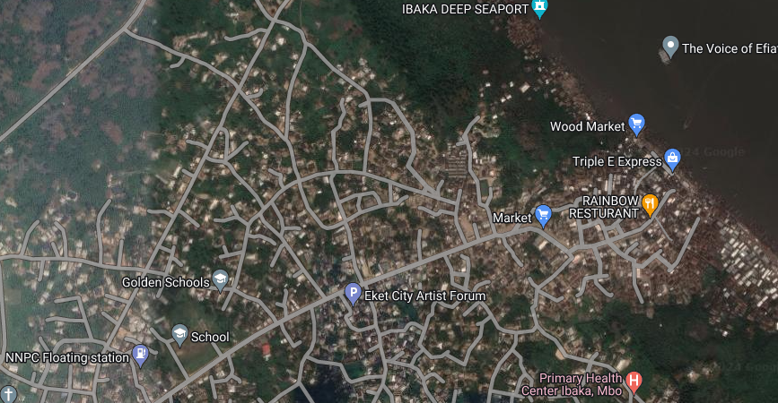
Overview of Cluster
S/N | DESCRIPTION | VALUE
1. | Average Hours of Supply | 4 Hours
2. | Number of Connections | 800
4. | Estimated Customer Population | 3,500
5. | ATC&C Loss | 52%
6. | Metering Penetration | 25%
7. | Average Monthly Collections | NGN30 million
LOCATION: Ibaka, Mbo Area Oron
72%
28%
ESTIMATED LOAD DEMAND: 0.7MW
RESIDENTIAL
COMMERCIAL & INDUSTRIAL
DISTRIBUTION INVESTMENT REQUIREMENT: NGN50 million

Slide 7
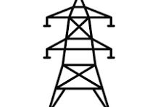
Infrastructure
POOR
STATE OF NETWORK
Top 3 Economic Activities
1. Mini Sea Port
2. Naval base
3. Retail Services
GOOD
ROAD ACCESSIBILITY
Feeder Route Length
30km
Voltage Level
33KV
Daily Load Profile
2.8MWh
Installed Transformer Capacity
1400KVA
GOOD
SECURITY STATUS
Network Limitations
Business Model
Embedded Generation
NO
PIP FOCUSED AREA
Vandalized 33KV Line And Collapsed Low tension Lines.

Slide 8
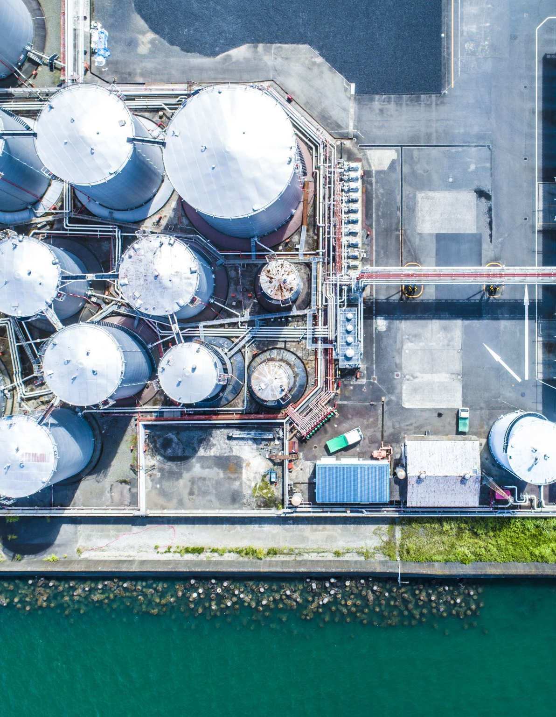
BETA 2 REGION
Economic Opportunities: The Beta 2 site in Onne, Rivers State, is strategically located near sea-ports, banks, and eateries, presenting significant economic opportunities. Investors can benefit from the thriving commercial activities, making this site an ideal candidate for investment due to the reliable power supply benefiting port operations and the banking sector.
Improvement Forecast: Increased power availability will enhance operational hours and efficiency for businesses in the area, leading to an 80% improvement in revenue collection efficiency. Reliable power supply will reduce downtime, increase productivity, and boost profits. This will attract more customers, thereby increasing revenue for the cluster and the region at large.

Slide 9
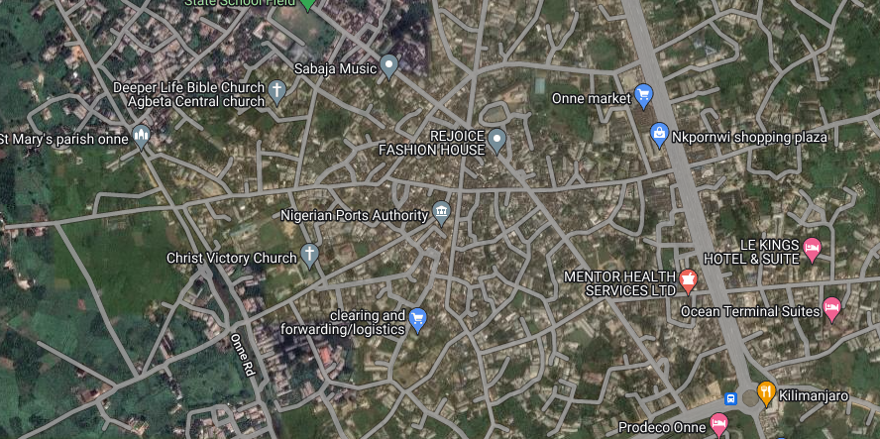
Overview of Cluster
S/N | DESCRIPTION | VALUE
1. | Average Hours of Supply | 5 Hours
2. | Number of Connections | 5,811
4. | Estimated Customer Population | 1,450
5. | ATC&C Loss | 48%
6. | Metering Penetration | 75%
7. | Average Monthly Collections | NGN10 million
LOCATION: Onne, Rivers
84%
16%
ESTIMATED LOAD DEMAND: 7.2MW
RESIDENTIAL
COMMERCIAL & INDUSTRIAL
DISTRIBUTION INVESTMENT REQUIREMENT: NGN10 million

Slide 10
Infrastructure
GOOD
STATE OF NETWORK
Top 3 Economic Activities
1. Sea Ports
2. Banks
3. Hospitals and other Retail Services
GOOD
ROAD ACCESSIBILITY
Feeder Route Length
7,5km
Voltage Level
33KV
Daily Load Profile
36MWh
Installed Transformer Capacity
11500KVA
GOOD
SECURITY STATUS
Network Limitations
Business Model
Embedded Generation
NO
PIP FOCUSED AREA
There are transmission bottlenecks on the feeder resulting in poor supply.

Slide 11
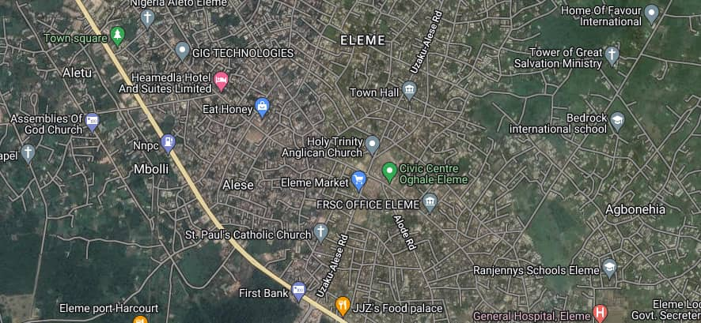
Overview of Cluster
S/N | DESCRIPTION | VALUE
1. | Average Hours of Supply | 5 Hours
2. | Number of Connections | 1,133
4. | Estimated Customer Population | 5,500
5. | ATC&C Loss | 48%
6. | Metering Penetration | 80%
7. | Average Monthly Collections | NGN20 million
LOCATION: Eleme, Rivers
76%
24%
ESTIMATED LOAD DEMAND: 5MW
RESIDENTIAL
COMMERCIAL & INDUSTRIAL
DISTRIBUTION INVESTMENT REQUIREMENT: NGN10 million

Slide 12
Infrastructure
FAIR
STATE OF NETWORK
Top 3 Economic Activities
1. Petrochemical Companies
2. Shopping Malls
3. Office Complexes
GOOD
ROAD ACCESSIBILITY
Feeder Route Length
6.5km
Voltage Level
33/11KV
Daily Load Profile
25MWh
Installed Transformer Capacity
7500KVA
GOOD
SECURITY STATUS
Network Limitations
Business Model
Embedded Generation
NO
PIP FOCUSED AREA
There are transmission bottlenecks on the feeder resulting in poor supply.

Slide 13
CALABAR REGION
Economic Opportunities: The Calabar sites in Bakassi, Oban, Eniong, Old Netim, Okoyong Usang Abasi are known for its fish farming industry, can greatly benefit from a stable power supply.
Improvement Forecast: Enhancing electricity availability will support the preservation and processing of fish, leading to increased economic activities. We expect a 40% improvement in revenue collection efficiency. Reliable power supply will reduce downtime, increase productivity, and boost profits. This will attract more customers, thereby increasing revenue for the cluster and the region at large.

Slide 14
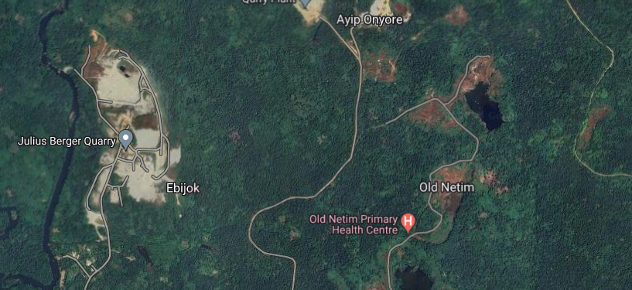
Overview of Cluster
S/N | DESCRIPTION | VALUE
1. | Average Hours of Supply | 4 Hours
2. | Number of Connections | 1,200
4. | Estimated Customer Population | 3,500
5. | ATC&C Loss | 36%
6. | Metering Penetration | 10%
7. | Average Monthly Collections | NGN20 million
LOCATION: Old Netim , Calabar
71%
29%
ESTIMATED LOAD DEMAND: 2MW
RESIDENTIAL
COMMERCIAL & INDUSTRIAL
DISTRIBUTION INVESTMENT REQUIREMENT: NGN50 million

Slide 15
Infrastructure
FAIR
STATE OF NETWORK
Top 3 Economic Activities
1. Stone Mine
2. Farming
3. Food & Beverage Service
GOOD
ROAD ACCESSIBILITY
Feeder Route Length
20km
Voltage Level
33KV
Daily Load Profile
8MWh
Installed Transformer Capacity
2500KVA
GOOD
SECURITY STATUS
Network Limitations
Business Model
Embedded Generation
NO
PIP FOCUSED AREA
There are transmission bottlenecks on the feeder resulting in poor supply.

Slide 16
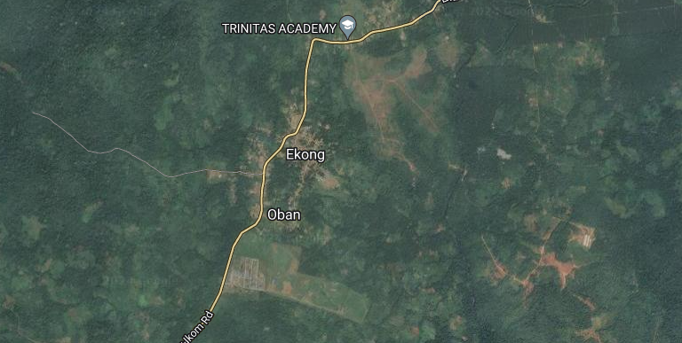
Overview of Cluster
S/N | DESCRIPTION | VALUE
1. | Average Hours of Supply | 4 Hours
2. | Number of Connections | 1750
4. | Estimated Customer Population | 4,500
5. | ATC&C Loss | 45%
6. | Metering Penetration | 10%
7. | Average Monthly Collections | NGN20 million
LOCATION: Oban, Calabar
70%
30%
ESTIMATED LOAD DEMAND: 2MW
RESIDENTIAL
COMMERCIAL & INDUSTRIAL
DISTRIBUTION INVESTMENT REQUIREMENT: NGN50 million

Slide 17
Infrastructure
FAIR
STATE OF NETWORK
Top 3 Economic Activities
1. Farming
2. Retail Services
3. Food & Beverage Service
GOOD
ROAD ACCESSIBILITY
Feeder Route Length
20km
Voltage Level
33KV
Daily Load Profile
8MWh
Installed Transformer Capacity
3200KVA
GOOD
SECURITY STATUS
Network Limitations
Business Model
Embedded Generation
NO
PIP FOCUSED AREA
There are transmission bottlenecks on the feeder resulting in poor supply.

Slide 18
OGOJA SUBREGION
Economic Opportunities: The sites in Ogoja Subregion is home to a diverse mix of commercial and small-scale industrial activities, along with the presence of the Federal College of Education.
Improvement Forecast: A reliable power supply will significantly enhance the operational efficiency of these businesses and educational institutions. Improved electricity availability will lead to better productivity, increased output, and higher quality of services and products. This, in turn, will attract more businesses to the area, creating jobs and stimulating economic growth.

Slide 19
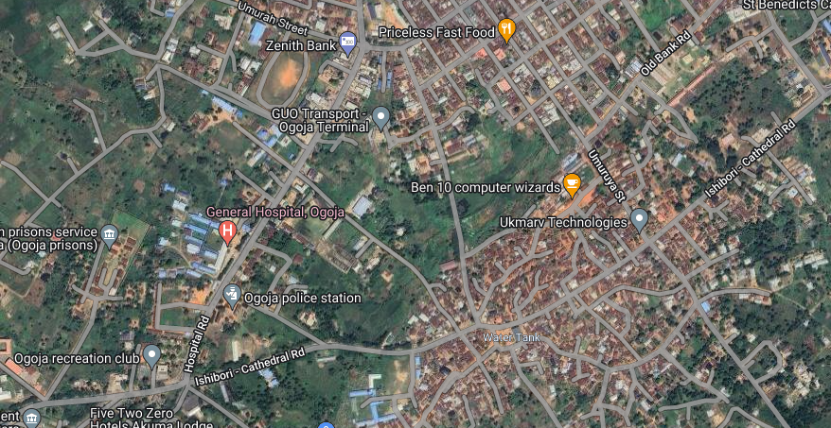
Overview of Cluster
S/N | DESCRIPTION | VALUE
1. | Average Hours of Supply | 20 Hours
2. | Number of Connections | 7,780
4. | Estimated Customer Population | 70,000
5. | ATC&C Loss | 34%
6. | Metering Penetration | 40%
7. | Average Monthly Collections | NGN20 million
LOCATION: Ogoja Town, Calabar
85%
15%
ESTIMATED LOAD DEMAND: 4.5MW
RESIDENTIAL
COMMERCIAL & INDUSTRIAL
DISTRIBUTION INVESTMENT REQUIREMENT: NGN80 million

Slide 20
Infrastructure
FAIR
STATE OF NETWORK
Top 3 Economic Activities
1. Presence Of A Large-Scale Rice Mill
2. Financial Institutions
3. Wood Mills, Welders
GOOD
ROAD ACCESSIBILITY
Feeder Route Length
420km
Voltage Level
33KV
Daily Load Profile
17MWh
Installed Transformer Capacity
5500KVA
GOOD
SECURITY STATUS
Network Limitations
Business Model
Embedded Generation
NO
PIP FOCUSED AREA
There are transmission bottlenecks on the feeder resulting in poor supply.

Slide 21
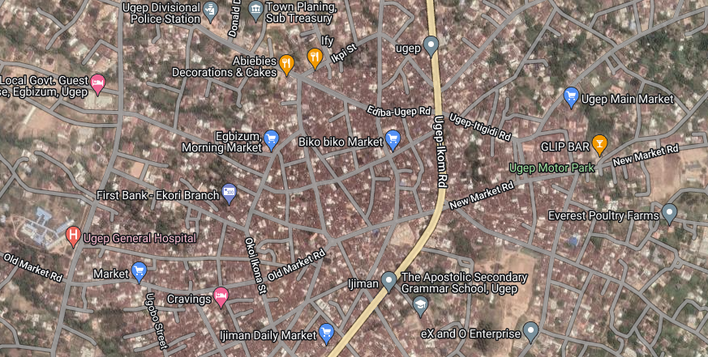
Overview of Cluster
S/N | DESCRIPTION | VALUE
1. | Average Hours of Supply | 4 Hours
2. | Number of Connections | 4590
4. | Estimated Customer Population | 79,000
5. | ATC&C Loss | 34%
6. | Metering Penetration | 60%
7. | Average Monthly Collections | NGN20 million
LOCATION: Ikom Town, Calabar
89%
11%
ESTIMATED LOAD DEMAND: 5.5MW
RESIDENTIAL
COMMERCIAL & INDUSTRIAL
DISTRIBUTION INVESTMENT REQUIREMENT: NGN80 million

Slide 22
Infrastructure
FAIR
STATE OF NETWORK
Top 3 Economic Activities
1. Cocoa Processing Outfit
2. Small scale Industrial Area
3. Hotels and Event Centers
GOOD
ROAD ACCESSIBILITY
Feeder Route Length
430km
Voltage Level
33KV
Daily Load Profile
22MWh
Installed Transformer Capacity
6500KVA
GOOD
SECURITY STATUS
Network Limitations
Business Model
Embedded Generation
NO
PIP FOCUSED AREA
There are transmission bottlenecks on the feeder resulting in poor supply.

Slide 23
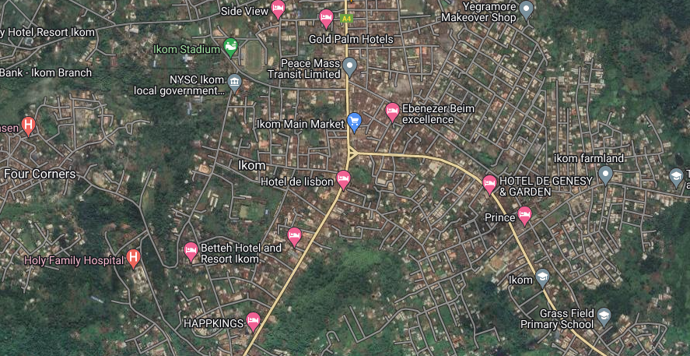
Overview of Cluster
S/N | DESCRIPTION | VALUE
1. | Average Hours of Supply | 4 Hours
2. | Number of Connections | 6,460
4. | Estimated Customer Population | 72,000
5. | ATC&C Loss | 49%
6. | Metering Penetration | 45%
7. | Average Monthly Collections | NGN20 million
LOCATION: Ugep Town, Calabar
88%
12%
ESTIMATED LOAD DEMAND: 4.5MW
RESIDENTIAL
COMMERCIAL & INDUSTRIAL
DISTRIBUTION INVESTMENT REQUIREMENT: NGN80 million

Slide 24
Infrastructure
FAIR
STATE OF NETWORK
Top 3 Economic Activities
1. Federal Polytechnic
2. Small scale manufacturing
3. Food & Beverage Service
GOOD
ROAD ACCESSIBILITY
Feeder Route Length
435km
Voltage Level
33KV
Daily Load Profile
17MWh
Installed Transformer Capacity
6000KVA
GOOD
SECURITY STATUS
Network Limitations
Business Model
Embedded Generation
NO
PIP FOCUSED AREA
There are transmission bottlenecks on the feeder resulting in poor supply.

