Slide 1
KEDCO
ABUJA ELECTRICITY DISTRIBUTION COMPANY
DER OPPORTUNITIES
KANO ELECTRICITY DISTRIBUTION PLC
PRESENTATION

Slide 2
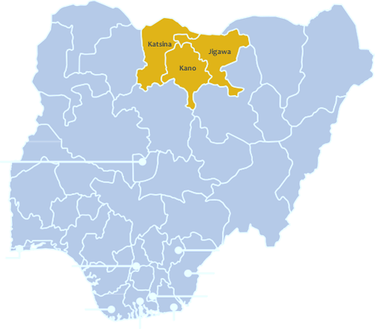
About KEDCO
KEDCO
Kano Electricity Distribution Company (KEDCO) is a utility company licensed to distribute electricity within Kano, Jigawa and Katsina States. Futures Energy Africa (FEA) is the company core investor with 60% stake while the Bureau of Public Enterprise (BPE)/ MOFI, own 40% stake on behalf of the Federal Government of Nigeria.
Coverage States
Kano, Katsina and Jigawa
Area covered
67,128 km2
MYTO load allocation
8% (6.7% actual)
Staff Strength
3293
Regions
14 Regions
Customer Number
700,000+
Transmission Sources
14 Transmission Stations
Assets and Inventory of KEDCO
Network
Core Values
68 33kV Feeders
123 11kV Feeders
Reliability
Integrity
Excellence
42 Injection Substations
8850 Distribution Transformers
202 Customer Service Points
Equity
Innovation
61 Technical Service Points
Mission
To be an efficient power distributor focused on customer satisfaction.
Reliability
Excellence
Vision
To enable re-industrialization and economic empowerment through safe and reliable power distribution

Slide 3
KEDCO
Kano Electricity Distribution Plc (KEDCO)
KEDCO’s DER plan will allow the DisCo to accelerate the replacement of aging infrastructure and increase its capacity to meet growing demand by integrating centralized and decentralized energy solutions.
KEDCO intends to leverage partnerships with Electricity Supply Companies (ESCOs) to resolve the energy shortage and quality issues faced in the franchise area.
The company has undertaken full clustering and segmentation analysis of its infrastructure and customer networks to appropriately determine and allocate sites for distributed energy supply, embedded generation and interconnected Mini-grid solutions.

Slide 4
KEDCO
Tokarawa 11KV

Slide 5
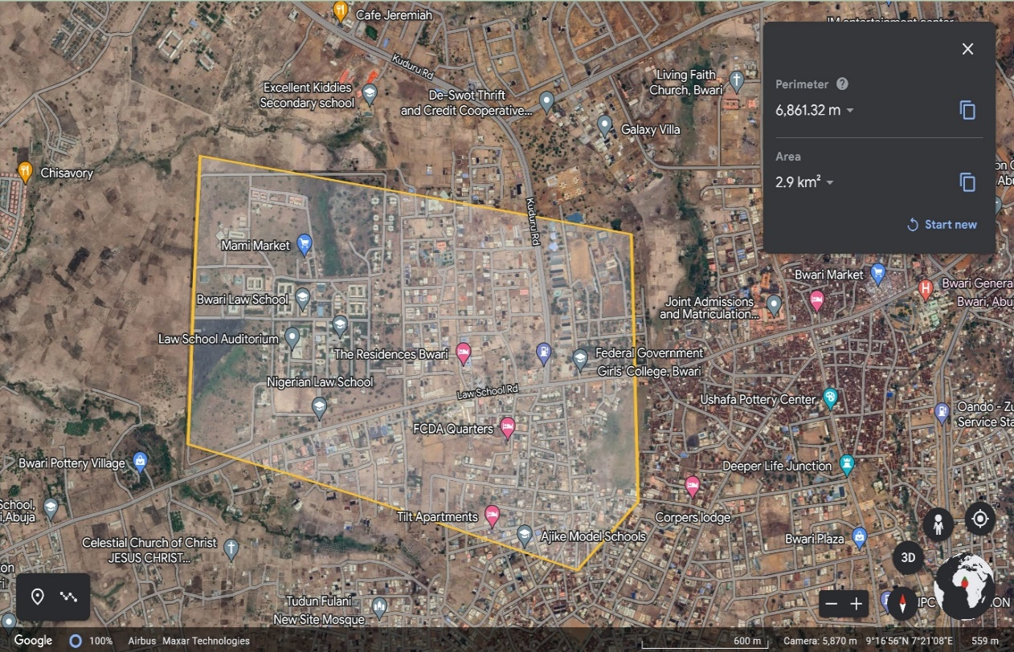
KEDCO
Overview of Tokarawa Industrial Cluster
S/N | DESCRIPTION | VALUE
1. | Average Hours of Supply | 20.28 Hours
2. | Number of Connections | 220
3. | Estimated Customer Population | 1,000
4. | ATC&C Loss | 25%
5. | Metering Penetration | 85%
6. | Average Monthly Collections | NGN57.5 million
LOCATION: Tokarawa Industrial Area, Kano
ESTIMATED LOAD DEMAND: 20MW
DISTRIBUTION INVESTMENT REQUIREMENT: NGN284 million
14%
86%
RESIDENTIAL
COMMERCIAL & INDUSTRIAL

Slide 6
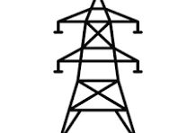
KEDCO
Infrastructure
GOOD
STATE OF NETWORK
Top 3 Economic Activities
1. Manufacturing
2. Processing
3. Packaging & Marketing
GOOD
ROAD ACCESSIBILITY
Feeder Route Length
22km
Voltage Level
11KV
Daily Load Profile
4.1 MWh
Approx. Installed Transformer Capacity
30,000KVA
GOOD
SECURITY STATUS
Network Limitations
Business Model
Embedded Generation/ IPP Solar – Hybrid
NO
PIP FOCUSED AREA
There are no transmission bottlenecks on the feeder

Slide 7
KEDCO
BAGAUDA 33KV

Slide 8
KEDCO
Overview of Kura & Karfi Cluster
S/N | DESCRIPTION | VALUE
1. | Average Hours of Supply | 12.23 Hours
2. | Number of Connections | 100
3. | Estimated Customer Population | 300
4. | ATC&C Loss | 57%
5. | Metering Penetration | 10%
6. | Average Monthly Collections | NGN13.3 million
LOCATION: Kura & Karfi Rice Millers, Kano
ESTIMATED LOAD DEMAND: 2.5MW
DISTRIBUTION INVESTMENT REQUIREMENT: NGN260 million
5%
95%
RESIDENTIAL
COMMERCIAL & INDUSTRIAL

Slide 9
KEDCO
Infrastructure
FAIR
STATE OF NETWORK
Top 3 Economic Activities
1. Rice Milling
2. Processing & Bagging
3. Trading & Marketing
GOOD
ROAD ACCESSIBILITY
Feeder Route Length
487km
Voltage Level
33KV
Daily Load Profile
8.4 MWh
Installed Transformer Capacity
1000KVA
GOOD
SECURITY STATUS
Network Limitations
Business Model
Interconnected Mini-grid
NO
PIP FOCUSED AREA
Lengthy feeder resulting in poor supply.

Slide 10
KEDCO
KARKASARA 11KV

Slide 11
KEDCO
Overview of Ado Bayero & FHE Cluster
S/N | DESCRIPTION | VALUE
1. | Average Hours of Supply | 8.05 Hours
2. | Number of Connections | 70
3. | Estimated Customer Population | 280
4. | ATC&C Loss | 67%
5. | Metering Penetration | 88.57%
6. | Average Monthly Collections | NGN18 million
LOCATION: Ado Bayero City/ Family House Estate Darmanawa (Gandun Sarki), Kano
ESTIMATED LOAD DEMAND: 2MW
DISTRIBUTION INVESTMENT REQUIREMENT: NGN138 million
94%
6%
RESIDENTIAL
COMMERCIAL & INDUSTRIAL

Slide 12
KEDCO
Infrastructure
FAIR
STATE OF NETWORK
Top 3 Economic Activities
Residencial
Petty Trading
GOOD
ROAD ACCESSIBILITY
Feeder Route Length
19km
Voltage Level
11KV
Daily Load Profile
6.5 MWh
Installed Transformer Capacity
1500KVA
GOOD
SECURITY STATUS
Network Limitations
Business Model
Interconnected Mini-grid
NO
PIP FOCUSED AREA
There is no transmission bottleneck on the feeder

Slide 13
KEDCO
NBC/ CERAMIC 11KV

Slide 14
KEDCO
Overview of Chalawa Industrial Cluster
S/N | DESCRIPTION | VALUE
1. | Average Hours of Supply | 22.55 Hours
2. | Number of Connections | 100
3. | Estimated Customer Population | 200
4. | ATC&C Loss | 24%
5. | Metering Penetration | 75%
6. | Average Monthly Collections | NGN123.5 million
LOCATION: Chalawa Phase 2, Kano
ESTIMATED LOAD DEMAND: 15 MW
DISTRIBUTION INVESTMENT REQUIREMENT: NGN 140 million
15%
85%
RESIDENTIAL
COMMERCIAL & INDUSTRIAL

Slide 15
KEDCO
Infrastructure
FAIR
STATE OF NETWORK
Top 3 Economic Activities
1. Manufacturing
2. Processing & Packaging
3. Trading & Marketing
GOOD
ROAD ACCESSIBILITY
Feeder Route Length
8km
Voltage Level
11KV
Daily Load Profile
5 MWh
Approx. Installed Transformer Capacity
30,000KVA
GOOD
SECURITY STATUS
Network Limitations
Business Model
Embedded Generation/ IPP Solar – Hybrid
NO
PIP FOCUSED AREA
There are no transmission bottlenecks on the feeder.

Slide 16
KEDCO
G.R.A 11KV

Slide 17
KEDCO
Overview of Barhim Estate Cluster
S/N | DESCRIPTION | VALUE
1. | Average Hours of Supply | 11.03 Hours
2. | Number of Connections | 500
4. | Estimated Customer Population | 600
5. | ATC&C Loss | 22.3%
6. | Metering Penetration | 85%
7. | Average Monthly Collections | NGN 31.4 million
LOCATION: Barhim Estate, Katsina
ESTIMATED LOAD DEMAND: 3MW
DISTRIBUTION INVESTMENT REQUIREMENT: NGN137 million
92%
8%
RESIDENTIAL
COMMERCIAL & INDUSTRIAL

Slide 18
KEDCO
Infrastructure
FAIR
STATE OF NETWORK
Top 3 Economic Activities
Residential
Petty Trading
GOOD
ROAD ACCESSIBILITY
Feeder Route Length
17km
Voltage Level
11KV
Daily Load Profile
6.8 MWh
Installed Transformer Capacity
1500KVA
GOOD
SECURITY STATUS
Network Limitations
Business Model
Interconnected Mini-grid
NO
PIP FOCUSED AREA
Inadequate grid supply resulting in poor supply.

Slide 19
KEDCO
Summary of KEDCO DER
S/N | Project | Estimated Load Demand (MW) | Number of Connections | Average Monthly Collections (NGN) m | Distribution Investment Required (NGN) m | Installed Distribition Transformer Capacity (kVA) | Proposed Business Model
1 | Tokarawa 11KV | 20 | 220 | 57.5 | 284 | 30,000 | Embedded Generation/ IPP Solar Hybrid
2 | Bagauda 33KV | 2.5 | 100 | 13.3 | 260 | 1000kVA | Interconnected Mini-grid
3 | Karkasara 11KV | 2 | 70 | 18 | 138 | 1500kVA | Interconnected Mini-grid
4 | NBC/Ceramic 11KV | 15 | 100 | 123.5 | 140 | 30,000KVA | Embedded Generation/ IPP Solar Hybrid
5 | G.R.A. 11KV | 3 | 500 | 31.3 | 137 | 1500kVA | Interconnected Mini-grid

Slide 20
KEDCO
THANK
YOU

