Slide 1
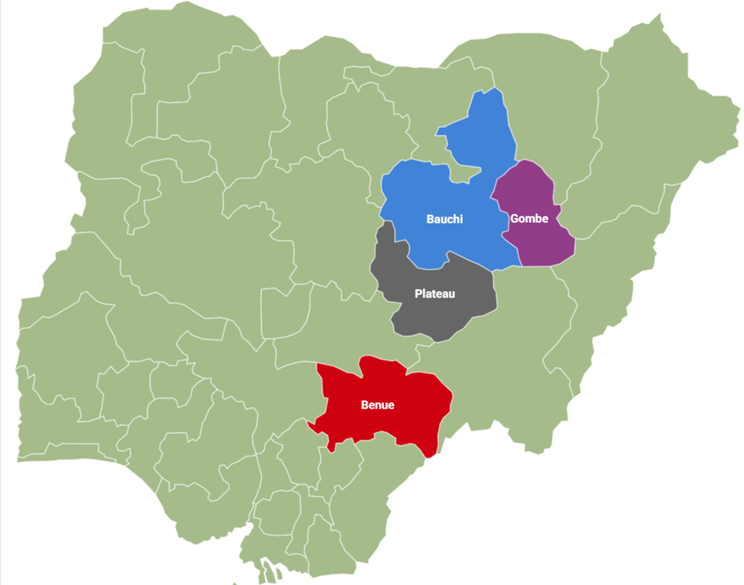
DER Opportunities Jos Electricity Distribution Plc

Slide 2
About JED Plc
JED Plc is one of Nigeria's privatized Electricity Distribution Companies (DisCos) following the 2005 Power Sector Reform Act.
Established on November 1st, 2013, and Headquartered in Jos, Plateau State with franchise area of Plateau, Gombe, Bauchi, and Benue States, JED Plc aims to be a top-quality electricity provider. .
JED Plc boasts an extensive distribution network covering 132,859 kM² and serving over 700,283 customers.
JED Plc is connected to eight Transmission Company of Nigeria (TCN) stations, ensuring reliable power distribution through eight Regional Offices, thirty Area Offices, and one hundred forty-seven Feeder Service Centers.
JED Plc Receives a daily average energy allocation of 6% from the National Grid (225MW daily average).
The current load demand of JED Plc is 361MW.
JED Plc Load deficit 136MW

Slide 3
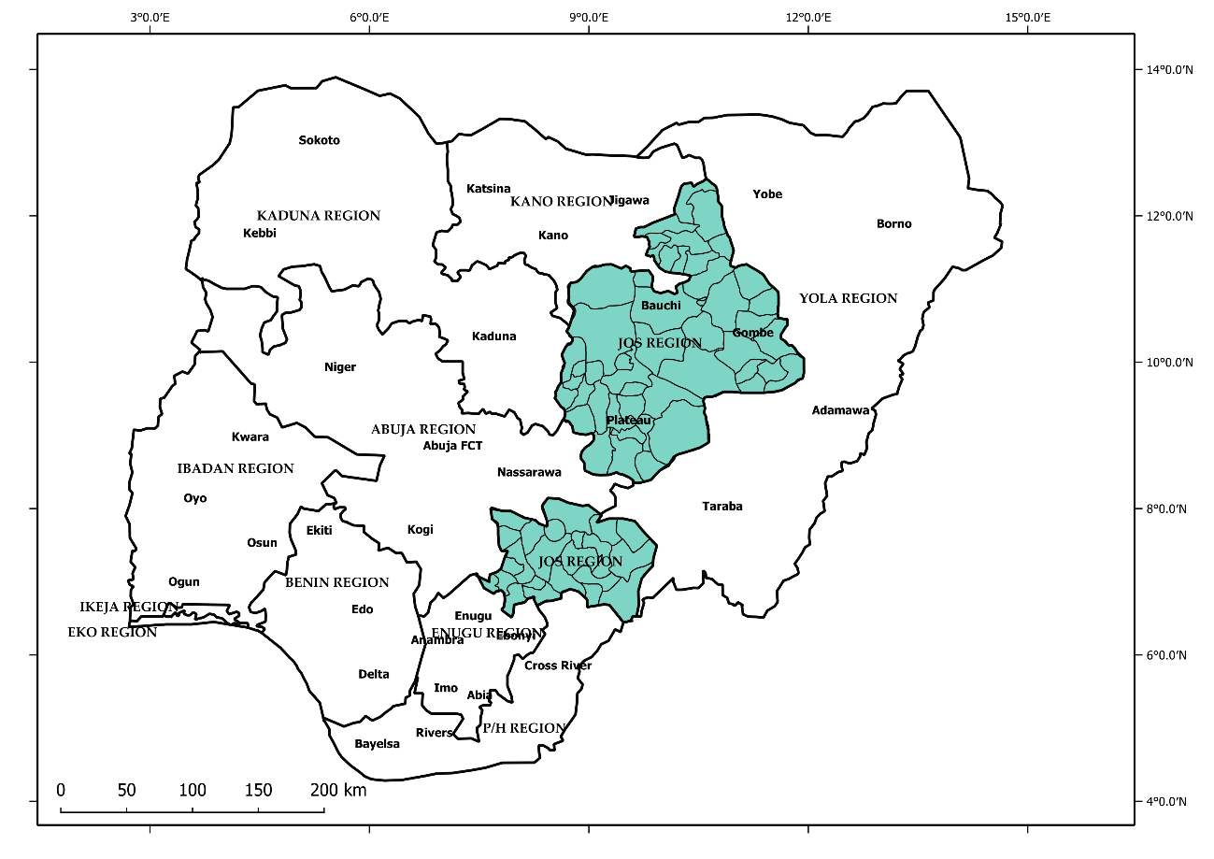
JEDP Franchise Area Map
Key Commercial Data
State | Population | Land Mass (KM²) | Installed Capacity (MVA) | 12-months Energy Delivered (MWh)
Bauchi | 6,997,314 | 49,119 | 391.51 | 195,142.15
Benue | 6,096,869 | 34,059 | 607.45 | 360,890.43
Gombe | 3,472,223 | 18,768 | 329.08 | 250,460.72
Plateau | 4,433,501 | 30,913 | 419.05 | 421,412.81
 | 20,999,907 | 132,859 | 1,747.09 | 1,227,906

Slide 4
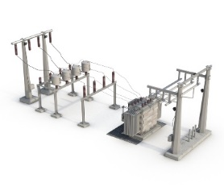
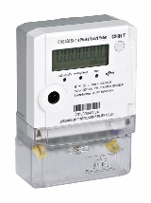
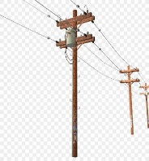
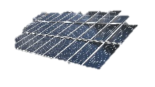
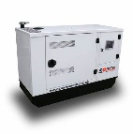
Overview of JEDC Franchising with EG Business Model
Applicability of the Models
JEDC charges Franchisee at the regulated tariff for electricity supply
JEDC
-
Franchisee
Single 33kV Feeder with Multiple DTs;
Single 11kV Feeder with Multiple DTs;
Single 0.415KV Distribution Transformer.
Franchisee reinforce the network to increase reliability and customer service
Franchisee collect tariff with surcharge approved by NERC to recover investment cost
70% of energy will be supplied to the franchisee by JEDC
Applicable to Feeders or DTs that consistently records 60% and Above ATC&C Loss
-
Procuring additional energy via bilateral contracts with Independent Power Producers (IPP) and/or Power Purchase Agreement (PPA) with embedded generators or self generation
JEDC sell energy to the franchisee through JEDC Distribution network
Franchisee collect tariff with surcharge approved by NERC to recover investment cost
Customer Willingness to pay premium service charges
Franchisee reinforce the network to increase reliability and customer service
Franchisee additional supply when JEDC supply is Off or inadequate
Franchisee Embedded generation
Distribution
JEDC Supply to Franchisee
-
System

Slide 5
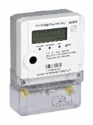
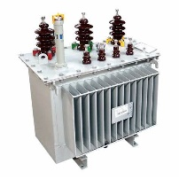
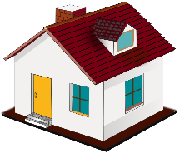
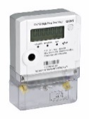
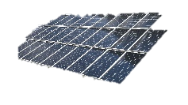
Overview of JEDC IMG Business Model
Applicability of the Models
JEDC charges Operator at the regulated tariff for electricity supply & DUoS charges
JEDC
-
Franchisee
Single 11kV Feeder with Multiple DTs;
Single or multiple 0.415KV Distribution Transformer.
Operator reinforce the network to increase reliability and customer service
Operator collect tariff and pay DUoS charges to JEDC for use of its network
Applicable to Rural Feeders or Rural communities or underserved areas
-
Tripartite agreement between JEDC, Developer/Operator & Community
Additional Generation <1MW
developer reinforce the network to increase reliability and meter the customers.
JEDC sell energy to the minigrid developer/operator through JEDC Distribution network
Franchisee additional supply when JEDC supply is Off or inadequate
Mini grid additional generation
Distribution
Community
-
System

Slide 6
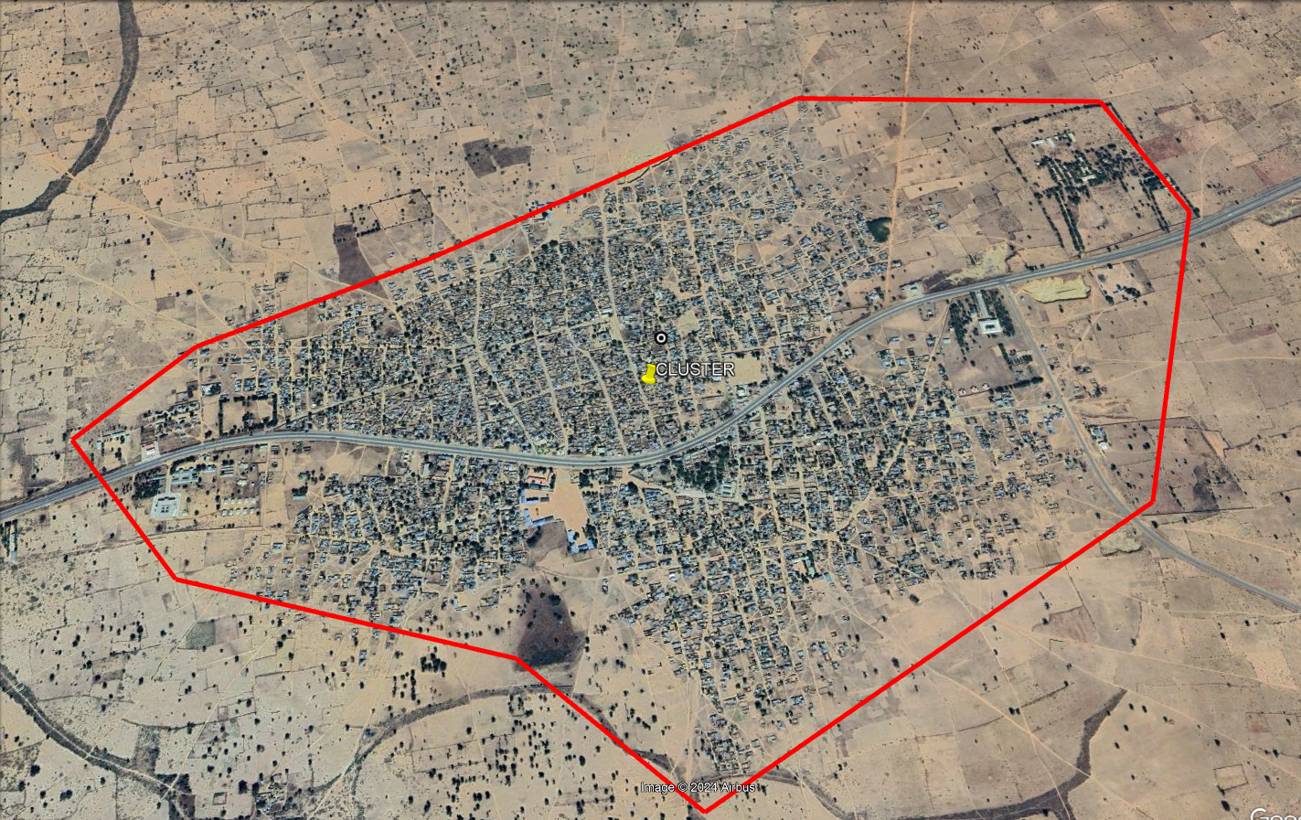
Dambam Community
Total Customer population: 670
Total Number of DTs: 6
Current Customer Population: 399
Estimated Community Population: >3000
Average Billing: N1,285,209
Average Collection: N315,676
ATC&C Loss Level: 79%
PPMs Population: 23
Business Model: IMG

Slide 7
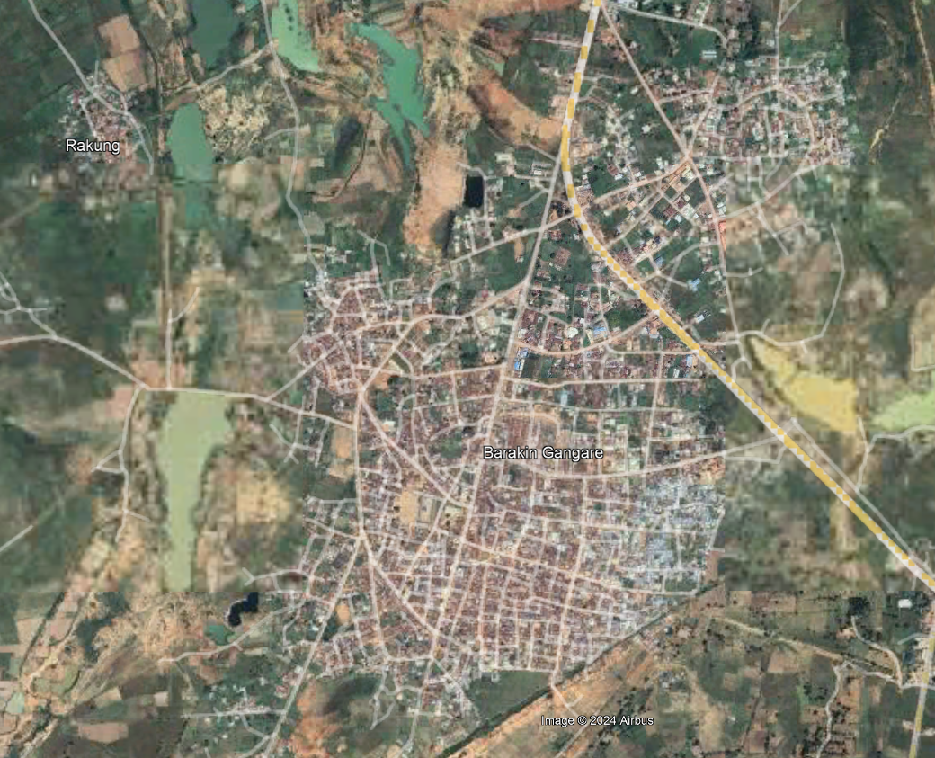
11kV Total Feeder
Total Customer population: 240
Total Number of DTs: 19
Feeder Band E
Current Customer Population: 240
Estimated Community Population: >7000
Average Billing: N 542,167
Average Collection: N 92,008
ATC&C Loss Level: 85%
PPMs Population: 3
Business Model: IMG

Slide 8
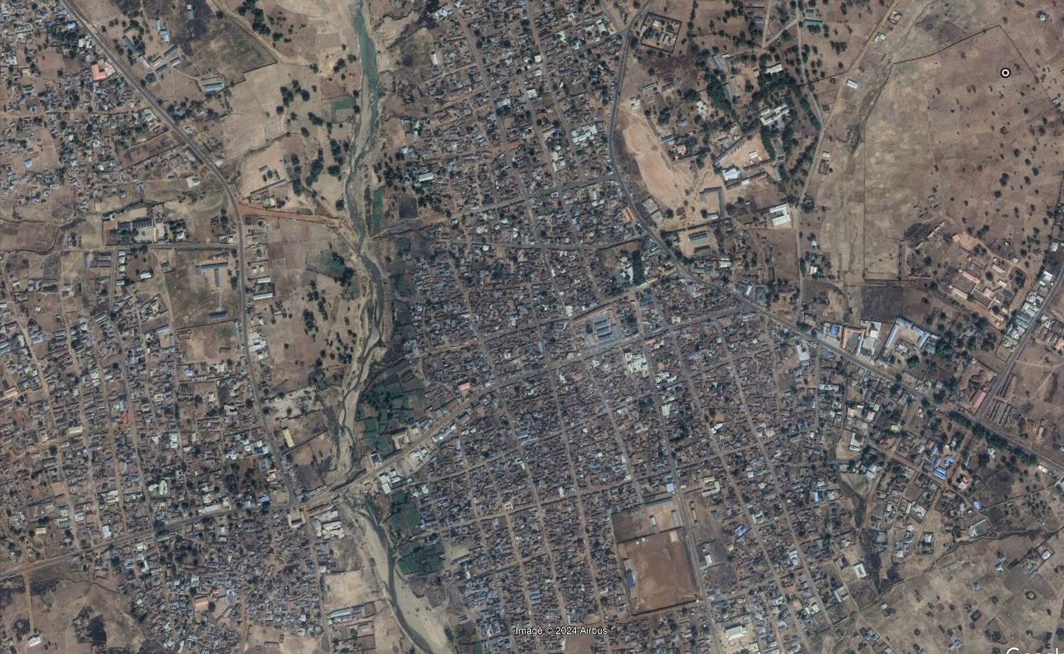
11kV Barikin Ladi
Total Customer population: 1,327
Total Number of DTs: 15
Feeder Band C
Current Customer Population: 1,327
Estimated Community Population: >10,000
Average Billing: N11,860,408
Average Collection: N4,021,524
ATC&C Loss Level: 73.81%
PPMs Population: 63
Business Model: IMG

Slide 9
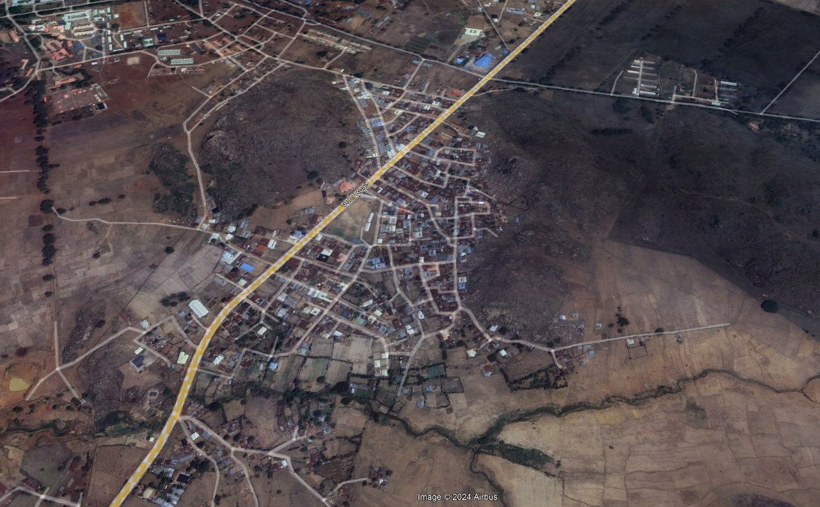
11kV Vom
Total Customer population: 2,759
Total Number of DTs: 43
Feeder Band C
Current Customer Population: 2,759
Estimated Community Population: >8,000
Average Billing: N 25,076,145
Average Collection: N 8,384,138
ATC&C Loss Level: 70.23%
PPMs Population: 300
Business Model: Franchising with EG

Slide 10
Interconnected Mini Grid Sites…
Feeder | Feeder 33KV | State | Number of Customers/connections | Top 3 Economic/commercial Activities in the cluster | Class of Customers | Feeder Voltage level (33/11kV) | Average hours of supply | Period of Supply | Customer Service | Is there load shedding for the site? | Reason for no supply (Technical or Commercial reason) | Estimated Load Demand (MW) | Estimated metering rate | Security Status | PIP focused Area (Yes/No) | ATC&C loss | Business Model
DENGI TOWN | DOROWA | Plateau | 331 | Agriculture, Trading and Mining | Residential, Commercial | 11KV | 7 | Day/Night | E | Yes | Commercial & Technical | 0.4 | 2% | Secured | No | 84% | Interconnected Mini Grid
GINDIRI | DOROWA | Plateau | 2,090 | Agriculture, Trading and Mining | Residential, Commercial | 11KV | 1 | Day/Night | C | Yes | Commercial & Technical | 1.1 | 3% | Secured | No | 59% | Interconnected Mini Grid
KUFFEN | DOROWA | Plateau | 637 | Agriculture, Trading and Mining | Residential, Commercial | 11KV | 1 | Day/Night | E | Yes | Commercial & Technical | 0.8 | 0% | Secured | No | 90% | Interconnected Mini Grid
SHENDAM BARRACKS | DOROWA | Plateau | 1203 - | Agriculture, Trading and Mining | Residential, Commercial | 11KV | 0 | Day/Night | E | Yes | Commercial & Technical | 0.8 | 0% | Secured | No | 0% | Interconnected Mini Grid

Slide 11
Interconnected Mini Grid Sites….
Feeder | Feeder 33KV | State | Number of Customers/connections | Estimated Cluster Population | Top 3 Economic/commercial Activities in the cluster | Class of customer | Feeder Name | Feeder Voltage level | Average hours of supply | Period of Supply | Customer Service Level Band | Reason for no supply (Technical or Commercial reason) | Estimated Load Demand (MW) | Estimated metering rate | PIP focused Area | ATC&C loss
TOTAL | DOROWA | Plateau | 240 | >1000 | Agriculture, Trading and Mining | Residential, Commercial | TOTAL | 11KV | 1 | Day/Night | E | Commercial | 2 | 1% | No | 76% | Interconnected Mini Grid
WASE GARKUWA | DOROWA | Plateau | 31 | >1000 | Agriculture, Trading and Mining | Residential, Commercial | WASE GARKUWA | 11KV | 0 | Day/Night | E | Commercial | 1 | 0% | No | 0% | Interconnected Mini Grid
WASE PRISON | DOROWA | Plateau | 509 | 6300 | Agriculture, Trading and Mining | Residential, Commercial | WASE PRISON | 11KV | 8 | Day/Night | E | Commercial | 3 | 0% | No | 69% | Interconnected Mini Grid
ZARTEX | DOROWA | Plateau | 310 | >300 | Agriculture, Trading and Mining | Residential, Commercial | ZARTEX | 11KV | 7 | Day/Night | C | Commercial | 1 | 9% | No | 79% | Interconnected Mini Grid
BENPOLY | ANKPA | Benue | 856 |  | Agriculture and Trading | Residential, Commercial | BENPOLY | 11KV | 7 | Day/Night | E | Commercial | 0.5 | 5% | No | 10% | Interconnected Mini Grid
UGBOKOLO | ANKPA | Benue | 215 |  | Agriculture and Trading | Residential, Commercial | UGBOKOLO | 11KV | 7 | Day/Night | E | Commercial | 0.2 | 23% | No | 86% | Interconnected Mini Grid

Slide 12
Franchising with Embedded Generation Sites
Feeder | Feeder 33KV | Feeder Bands - May 2024 | Location | Region/Area Office | State | Number of Customers/connections | Top 3 Economic/commercial Activities in the cluster | Class of customer and Mix | Feeder Name | Feeder Voltage level (33/11kV) | Average hours of supply | Period of Supply | Is there load shedding for the site? | Reason for no supply | Estimated Load Demand (MW) | Estimated metering rate | ATC&C Loss Level
VOM | BUKURU | C | VOM, Bukuru | BUKURU | Plateau | 2,789 | Agriculture, Trading and Mining | Residential, Commercial, Industry | VOM | 11KV | 12 | Day/Night | Yes | Commercial & Technical | 2.5 | 8% | 82%
BARIKIN LADI TOWN | DOROWA | C | BARIKIN LADI TOWN | BUKURU | Plateau | 1,327 | Agriculture, Trading and Mining | Residential, Commercial | BARIKIN LADI TOWN | 11KV | 8 | Day/Night | Yes | Commercial & Technical | 1.6 | 3% | 80%
DAUDU | NORTH BANK | D | DAUDU, North Bank, Makurdi | MAKURDI | Benue | 2,927 | Agriculture and Trading | Residential, Commercial | DAUDU | 11KV | 9 | Day/Night | Yes | Commercial & Technical | 6 | 15% | 74%
SRS | NORTH BANK | C | SRS, North Bank, Makurdi | MAKURDI | Benue | 2,287 | Agriculture and Trading | Residential, Commercial | SRS | 11KV | 7 | Day/Night | Yes | Commercial & Technical | 8 | 18% | 76%
UGBOKOLO 33KV | ANKPA | E | UGBOKOLO Town, Otukpo | MAKURDI | Benue | 2,984 | Agriculture and Trading | Residential, Commercial | UGBOKOLO 33KV | 33KV | 7 | Day/Night | Yes | Commercial & Technical | 1.5 | 100% | 80%
ALIADE | TARAKU | C | ALIADE Town, Otukpo | MAKURDI | Benue | 1,102 | Agriculture and Trading | Residential, Commercial | ALIADE | 11KV | 8 | Day/Night | Yes | Commercial & Technical | 1 | 2% | 86%

Slide 13

Thank You

