Slide 1
ABUJA ELECTRICITY DISTRIBUTION COMPANY
DER OPPORTUNITIES
EKO ELECTRICITY DISTRIBUTION PLC
PRESENTATION

Slide 2
Eko Electricity Distribution Plc (EKEDP) Profile
Eko Electricity Distribution Plc (EKEDP) of 24/25, Marina, Lagos was licensed in November 2013 under the Electric Power Sector Recovery Act (EPSRA) 2005 to provide electricity distributions services to the southern part of Lagos State and Agbara, Ogun State, Nigeria, known as its franchise area.
EKEDPs electricity distribution network operates at three (3) voltage levels namely 33kV, 11kV and 0.415kV and serves residential, commercial, and industrial hubs in its districts; Agbara, Ajele, Ajah, Apapa, Festac, Ibeju, Ijora, Islands, Lekki, Mushin, Ojo and Orile with a customer base of about 693,478.
EKEDP is jointly owned by West Power and Gas (WPG) which holds majority shares and the Federal Government through the Bureau of Public Enterprise (BPE).
EKEDP has 53 Injection Sub-stations, 92 (33kV) feeders, 324 (11kV) feeders and above 12,000 Distribution transformers within its distribution network which receives supply from 12 Transmission Substation with the three 3 main points being (1) Ajah (2) Akangba (3) Ikeja West.

Slide 3
Eko Electricity Distribution Plc (EKEDP) Profile
VISION:
To be the leading and customer centric power utility in Africa, and to be the preferred choice of all stakeholders.
MISSION:
Our mission is to improve the quality of life for all customers and stakeholders by utilizing cutting-edge technology and innovative processes to sustainably, reliably, and safely supply electricity.
CORE VALUES- (i-serve):
Integrity
Safety
Empathy
Responsiveness
Value-Driven
Excellence

Slide 4
OKO AFO

Slide 5
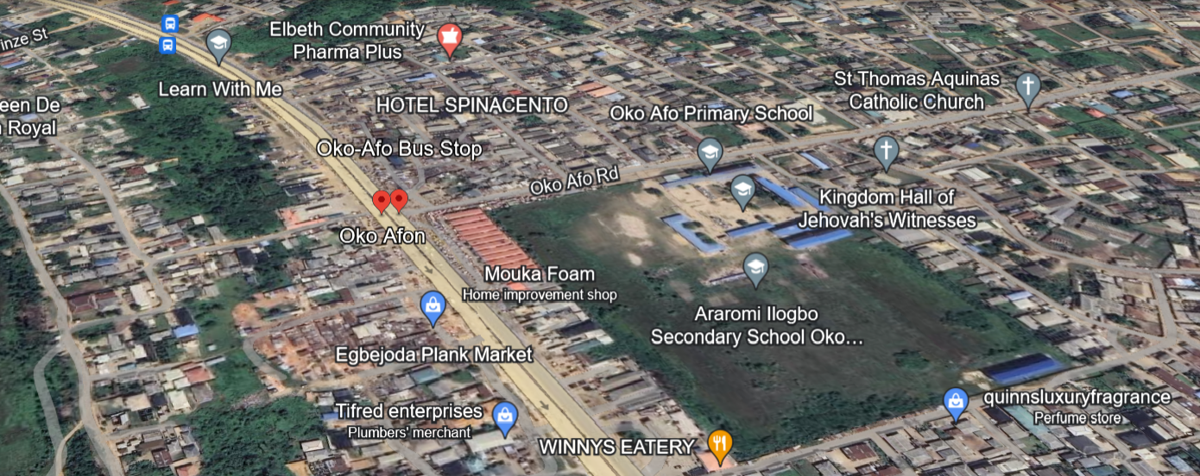
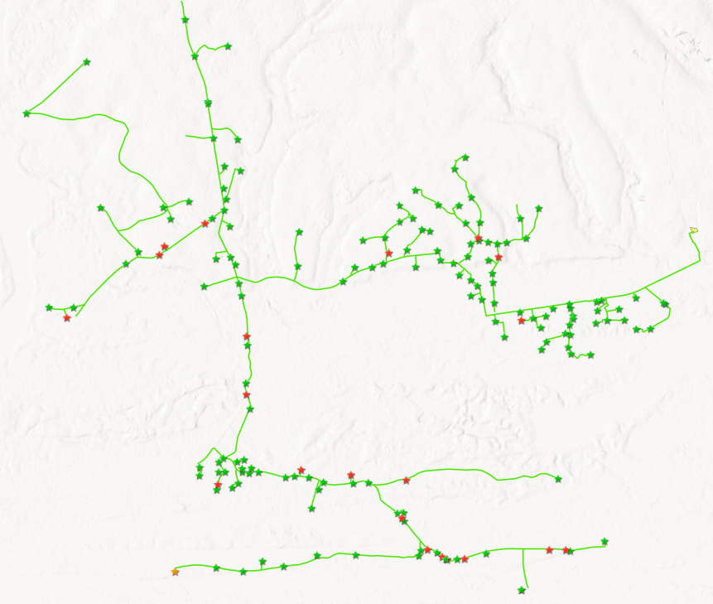
Overview of Cluster
S/N | DESCRIPTION | VALUE
1. | Average Hours of Supply | 12.8 Hours
2. | Number of Connections | 36,196
4. | Estimated Customer Population | 39,815
5. | Collection % (Jan-Jun 2024) | 61%
6. | Metering Penetration | 24%
7. | Average Monthly Collections | NGN80.15million
85%
15%
LOCATION: Oko Afo
ESTIMATED LOAD DEMAND: 28MW, DAILY LOAD: 7.3MW
RESIDENTIAL
COMMERCIAL & INDUSTRIAL
DISTRIBUTION INVESTMENT REQUIREMENT: NGN 725.27 million

Slide 6
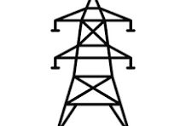
Infrastructure
FAIR
STATE OF NETWORK
Top 3 Economic Activities
1. Retail Services
2. Crafts
GOOD
ROAD ACCESSIBILITY
Feeder Route Length
127.9 km
Voltage Level
33KV
Daily Load Profile
7.3 MWh
Installed Transformer Capacity
67.22 MVA
GOOD
SECURITY STATUS
Network Limitations
Business Model
Franchising
NO
PIP FOCUSED AREA
Feeder rehabilitation required

Slide 7
OTTO AWORI

Slide 8
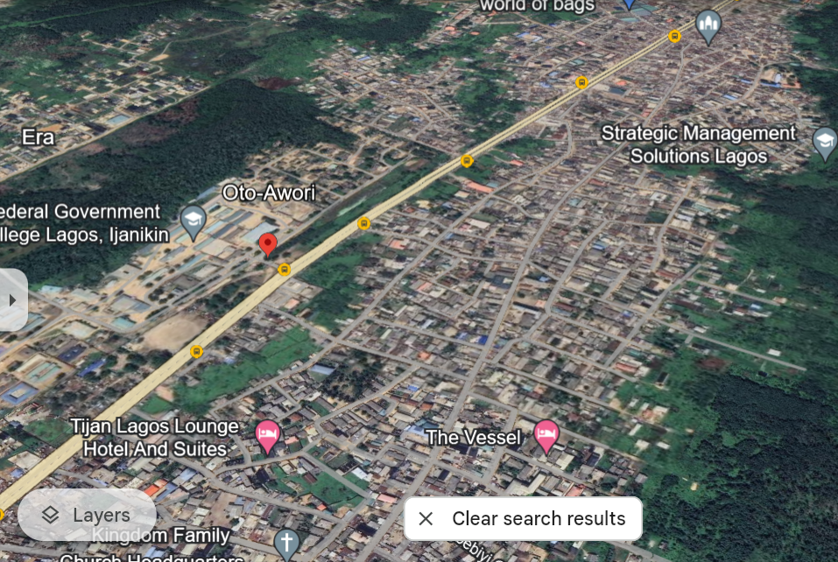
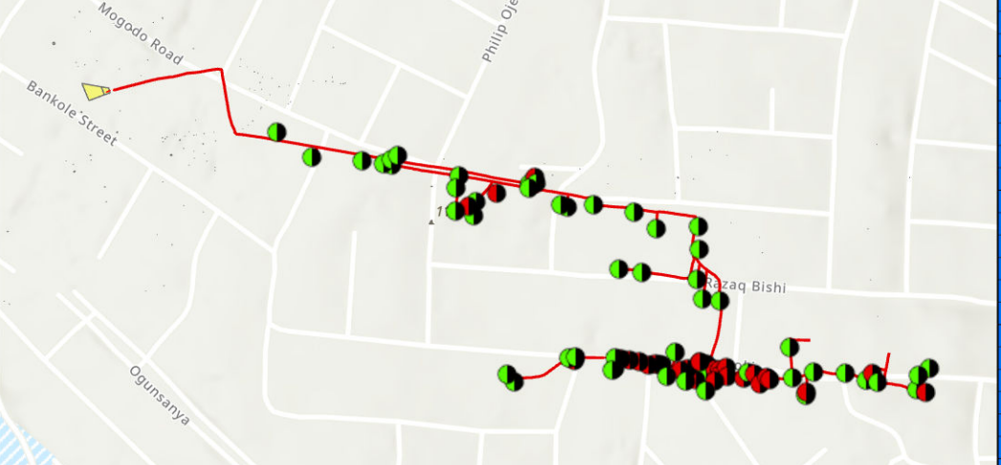
Overview of Cluster
S/N | DESCRIPTION | VALUE
1. | Average Hours of Supply | 8.5Hours
2. | Number of Connections | 8,849
4. | Estimated Customer Population | 9,733
5. | Collection % (Jan-Jun 2024) | 74%
6. | Metering Penetration | 40%
7. | Average Monthly Collections | NGN29.13million
90%
10%
LOCATION: Otto Awori
ESTIMATED LOAD DEMAND: 5.3MW DAILY LOAD: 3.3MWh
RESIDENTIAL
COMMERCIAL & INDUSTRIAL
DISTRIBUTION INVESTMENT REQUIREMENT: NGN 169.27 million

Slide 9
Infrastructure
FAIR
STATE OF NETWORK
Top 3 Economic Activities
1. Retail Services
2. Crafts
3. Fishing & Farming
GOOD
ROAD ACCESSIBILITY
Feeder Route Length
22.2 km
Voltage Level
11KV
Daily Load Profile
3.3MWh
Installed Transformer Capacity
22 MVA
GOOD
SECURITY STATUS
Network Limitations
Business Model
Franchising
NO
PIP FOCUSED AREA
Feeder rehabilitation required

Slide 10
ELEKO

Slide 11
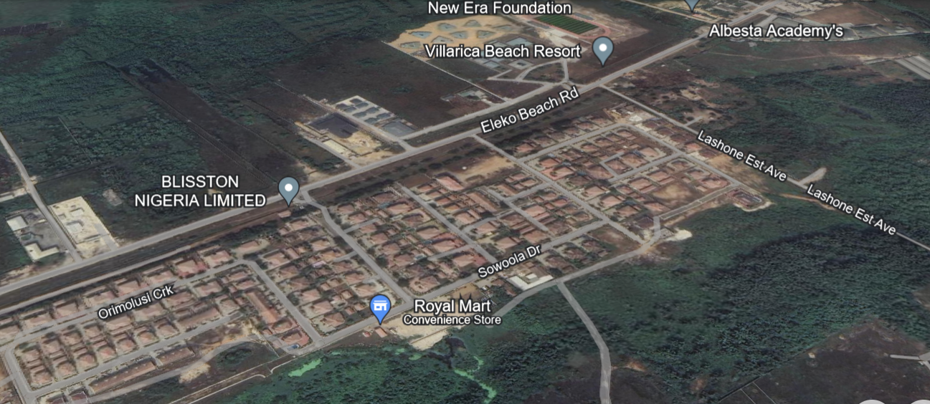
Overview of Cluster
S/N | DESCRIPTION | VALUE
1. | Average Hours of Supply | 9.6Hours
2. | Number of Connections | 22,490
4. | Estimated Customer Population | 24,739
5. | Collection % (Jan-Jun 2024) | 85%
6. | Metering Penetration | 39%
7. | Average Monthly Collections | NGN62.4million
70%
30%
LOCATION: Eleko
RESIDENTIAL
ESTIMATED LOAD DEMAND:26MW DAILY LOAD: 8.2MW
COMMERCIAL & INDUSTRIAL
DISTRIBUTION INVESTMENT REQUIREMENT: NGN1.07billion

Slide 12
Infrastructure
FAIR
STATE OF NETWORK
Top 3 Economic Activities
1. Retail Services
2. Crafts
3. Farming & Fishing
4. Small scale industries
GOOD
ROAD ACCESSIBILITY
Feeder Route Length
297.3 km
Voltage Level
33KV
Daily Load Profile
8.2MWh
Installed Transformer Capacity
160.75 MVA
GOOD
SECURITY STATUS
Network Limitations
Business Model
Franchising
NO
PIP FOCUSED AREA
Feeder rehabilitation required

Slide 13
IJANIKIN

Slide 14
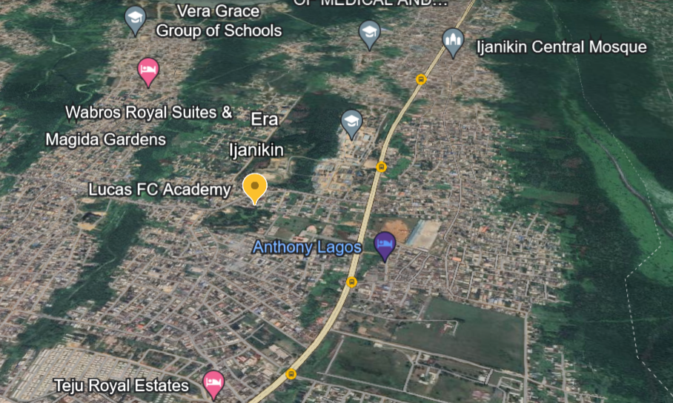
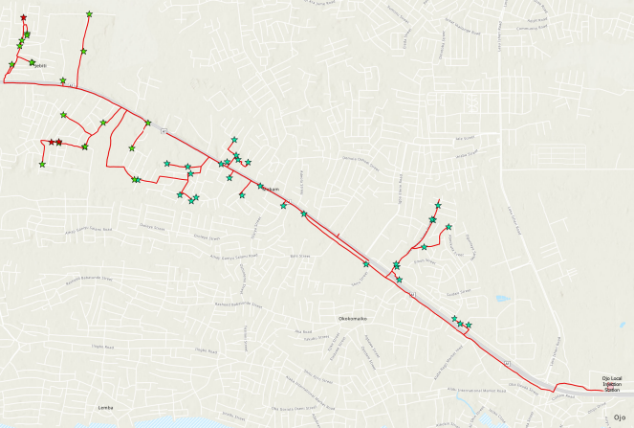
Overview of Cluster
S/N | DESCRIPTION | VALUE
1. | Average Hours of Supply | 4.4 Hours
2. | Number of Connections | 7,362
4. | Estimated Customer Population | 8.098
5. | Collection % (Jan-Jun 2024) | 89%
6. | Metering Penetration | 51%
7. | Average Monthly Collections | NGN21.09 million
80%
20%
LOCATION: ijanikin
RESIDENTIAL
ESTIMATED LOAD DEMAND: 5.8MW DAILY LOAD: 4.2MW
COMMERCIAL & INDUSTRIAL
DISTRIBUTION INVESTMENT REQUIREMENT: NGN146.20million

Slide 15
Infrastructure
FAIR
STATE OF NETWORK
Top 3 Economic Activities
1. Retail Services
2. Crafts 3. Fishing & Farming
4. Government Parastatals
GOOD
ROAD ACCESSIBILITY
Feeder Route Length
21.8 km
Voltage Level
11KV
Daily Load Profile
4.2MWh
Installed Transformer Capacity
18.85MVA
GOOD
SECURITY STATUS
Network Limitations
Business Model
Franchising
NO
PIP FOCUSED AREA
Feeder rehabilitation required

Slide 16
ELEMORO

Slide 17
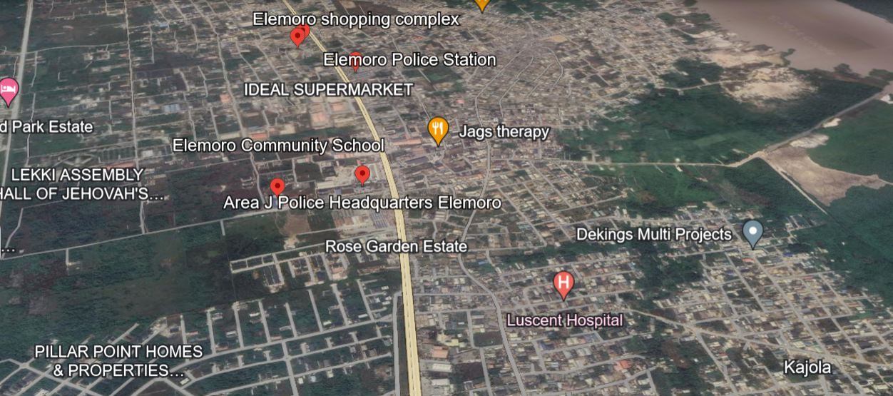
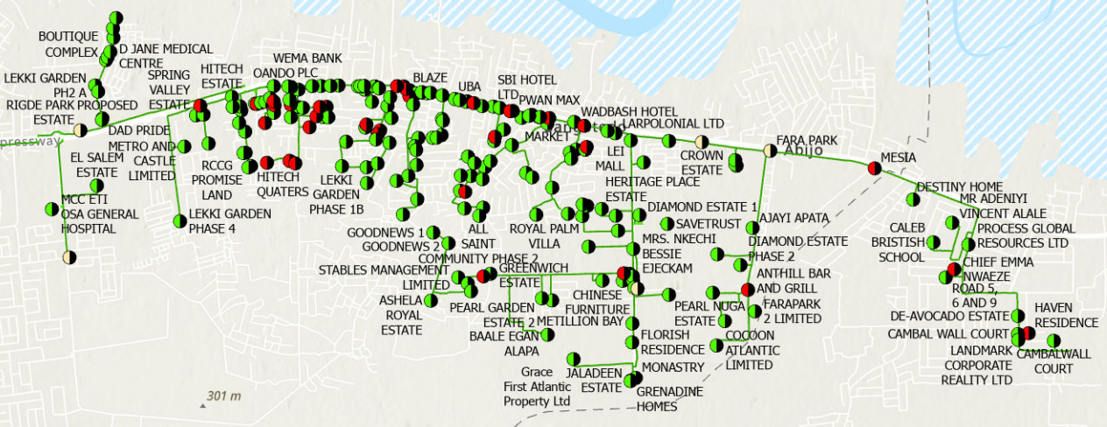
Overview of Cluster
S/N | DESCRIPTION | VALUE
1. | Average Hours of Supply | 13.4 Hours
2. | Number of Connections | 11,956
4. | Estimated Customer Population | 13,151
5. | Collection % (Jan-Jun 2024) | 91%
6. | Metering Penetration | 85%
7. | Average Monthly Collections | NGN199.83million
72%
28%
LOCATION: Elemoro
RESIDENTIAL
ESTIMATED LOAD DEMAND: 27MW DAILY LOAD: 11.9MW
COMMERCIAL & INDUSTRIAL
DISTRIBUTION INVESTMENT REQUIREMENT: NGN725.27million

Slide 18
Infrastructure
FAIR
STATE OF NETWORK
Top 3 Economic Activities
1. Retail Services
2. Crafts 3. Fishing & Farming
4. Small industries
GOOD
ROAD ACCESSIBILITY
Feeder Route Length
294.6km
Voltage Level
33KV
Daily Load Profile
11.9 MWh
Installed Transformer Capacity
88 MVA
GOOD
SECURITY STATUS
Network Limitations
Business Model
Franchising
NO
PIP FOCUSED AREA
Feeder rehabilitation required

Slide 19
IBEJU

Slide 20
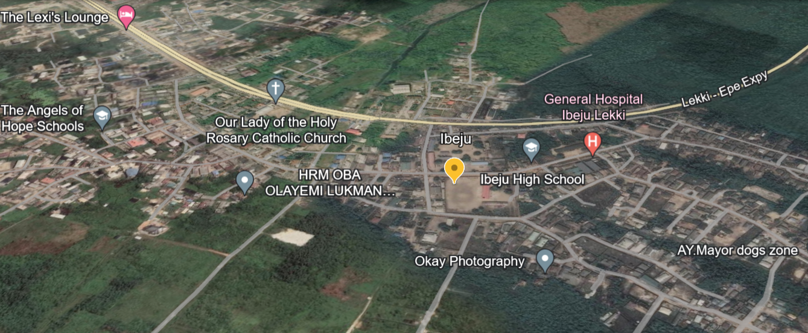
Overview of Cluster
S/N | DESCRIPTION | VALUE
1. | Average Hours of Supply | 8.3 Hours
2. | Number of Connections | 30,961
4. | Estimated Customer Population | 34,057
5. | Collection % (Jan-Jun 2024) | 84%
6. | Metering Penetration | 67%
7. | Average Monthly Collections | NGN118.71million
65%
35%
LOCATION: Ibeju
RESIDENTIAL
ESTIMATED LOAD DEMAND: 24.8MW DAILY LOAD : 11.3MW
COMMERCIAL & INDUSTRIAL
DISTRIBUTION INVESTMENT REQUIREMENT: NGN644.21million

Slide 21
Infrastructure
FAIR
STATE OF NETWORK
Top 3 Economic Activities
1. Retail Services
2. Crafts 3. Fishing & Farming
4. Small industries
GOOD
ROAD ACCESSIBILITY
Feeder Route Length
57.4km
Voltage Level
33KV
Daily Load Profile
11.3 MWh
Installed Transformer Capacity
106.6 MVA
GOOD
SECURITY STATUS
Network Limitations
Business Model
Franchising
NO
PIP FOCUSED AREA
Feeder rehabilitation required

Slide 22
BADAGRY 33

Slide 23
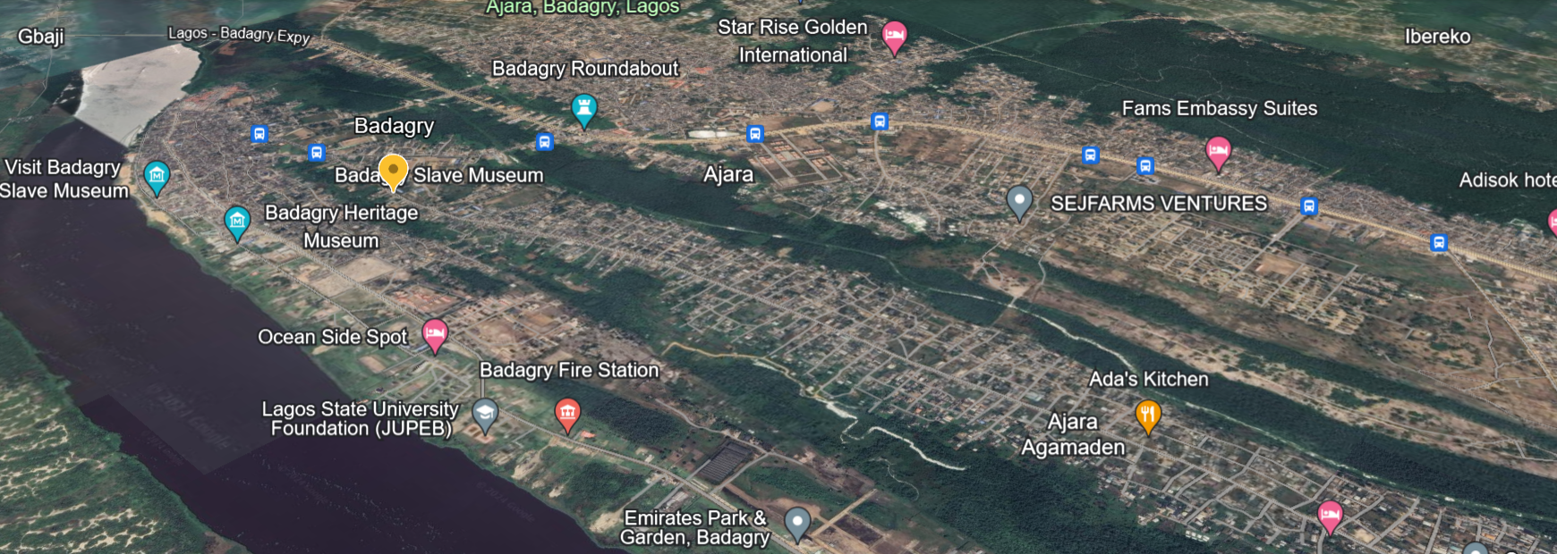
Overview of Cluster
S/N | DESCRIPTION | VALUE
1. | Average Hours of Supply | 10.8 Hours
2. | Number of Connections | 24,700
4. | Estimated Customer Population | 27,170
5. | Collection % (Jan-Jun 2024) | 62%
6. | Metering Penetration | 28%
7. | Average Monthly Collections | NGN70.66million
80%
20%
LOCATION: Badagry 33
RESIDENTIAL
ESTIMATED LOAD DEMAND: 3.2MW DAILY LOAD: 7.9MW
COMMERCIAL & INDUSTRIAL
DISTRIBUTION INVESTMENT REQUIREMENT: NGN453.29million

Slide 24
Infrastructure
FAIR
STATE OF NETWORK
Top 3 Economic Activities
1. Retail Services
2. Crafts 3. Fishing & Farming
4. small-mid size Industries
GOOD
ROAD ACCESSIBILITY
Feeder Route Length
30.9km
Voltage Level
33KV
Daily Load Profile
7.9 MWh
Installed Transformer Capacity
69.83MVA
GOOD
SECURITY STATUS
Network Limitations
Business Model
Franchising
NO
PIP FOCUSED AREA
Feeder rehabilitation required

Slide 25
OGOMBO

Slide 26
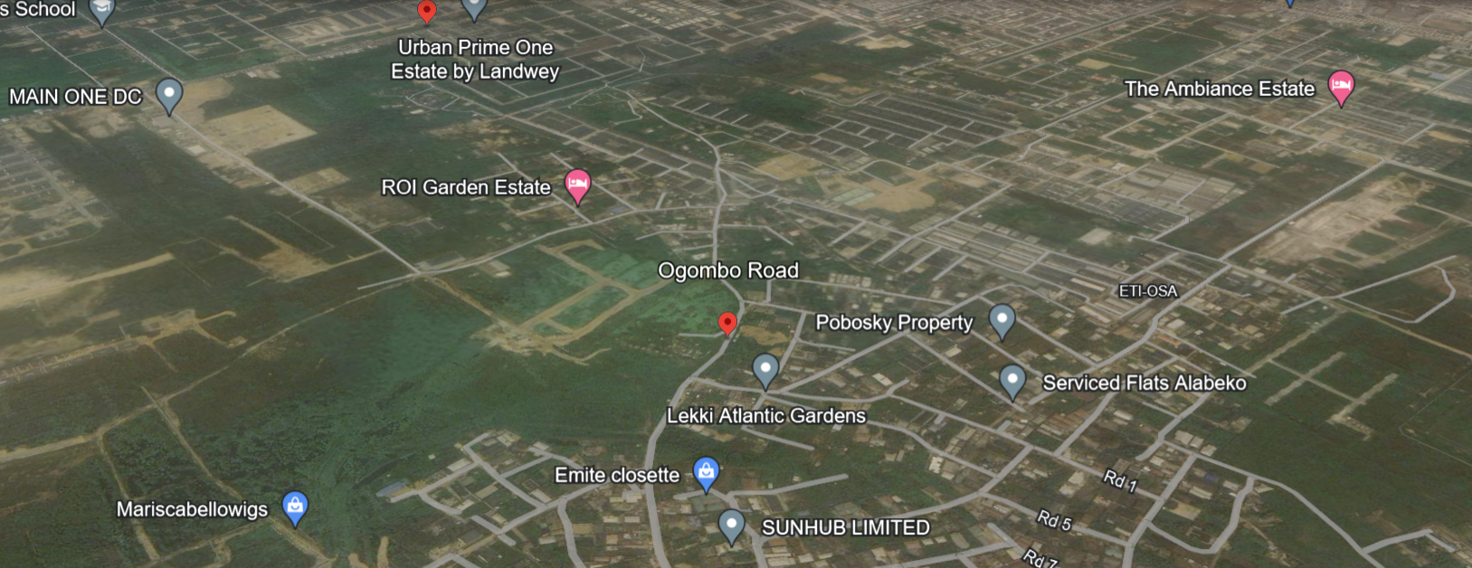
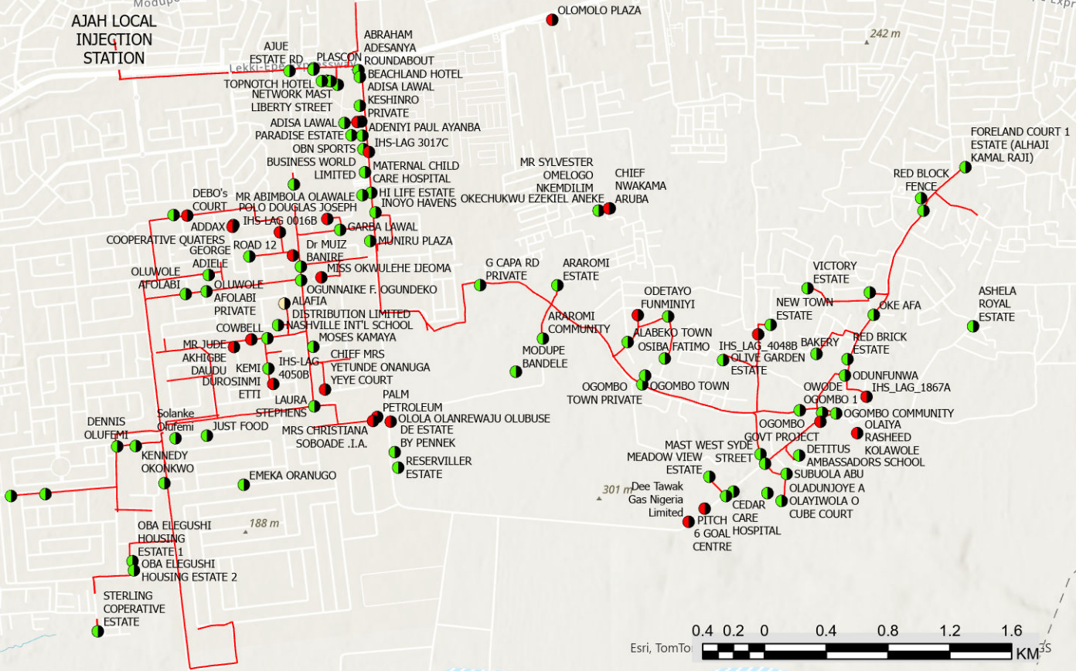
Overview of Cluster
S/N | DESCRIPTION | VALUE
1. | Average Hours of Supply | 7.5 Hours
2. | Number of Connections | 5,135
4. | Estimated Customer Population | 5,648
5. | Collection % (Jan-Jun 2024) | 76%
6. | Metering Penetration | 69%
7. | Average Monthly Collections | NGN46.26million
80%
20%
LOCATION: Ogombo
RESIDENTIAL
ESTIMATED LOAD DEMAND: 5.7MW DAILY LOAD: 3.2MW
COMMERCIAL & INDUSTRIAL
DISTRIBUTION INVESTMENT REQUIREMENT: NGN222.83million

Slide 27
Infrastructure
FAIR
STATE OF NETWORK
Top 3 Economic Activities
1. Retail Services
2. Crafts 3. Fishing & Farming
4. small-mid size Industries
GOOD
ROAD ACCESSIBILITY
Feeder Route Length
3.2 km
Voltage Level
11KV
Daily Load Profile
3.2 MWh
Installed Transformer Capacity
27.65MVA
GOOD
SECURITY STATUS
Network Limitations
Business Model
Franchising
NO
PIP FOCUSED AREA
Feeder rehabilitation required

Slide 28
AJARA

Slide 29
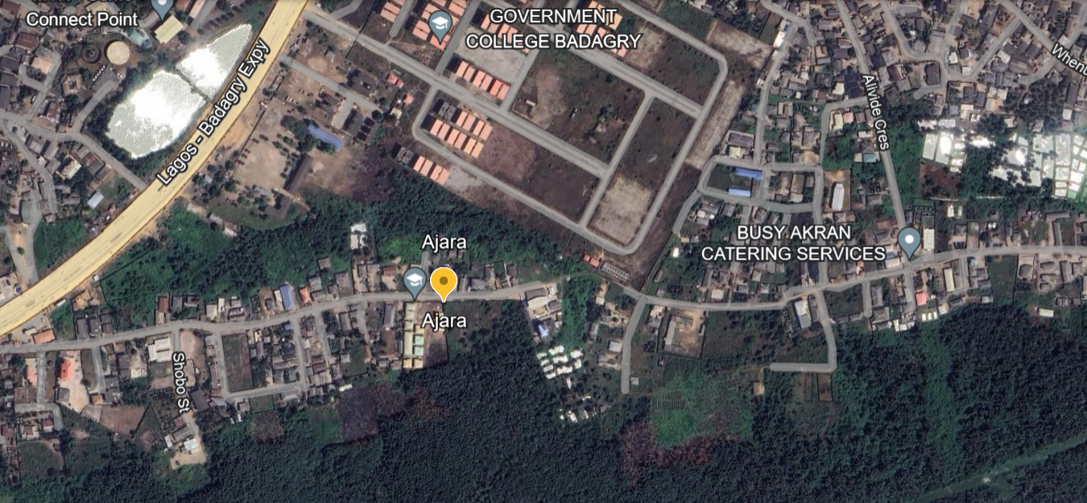
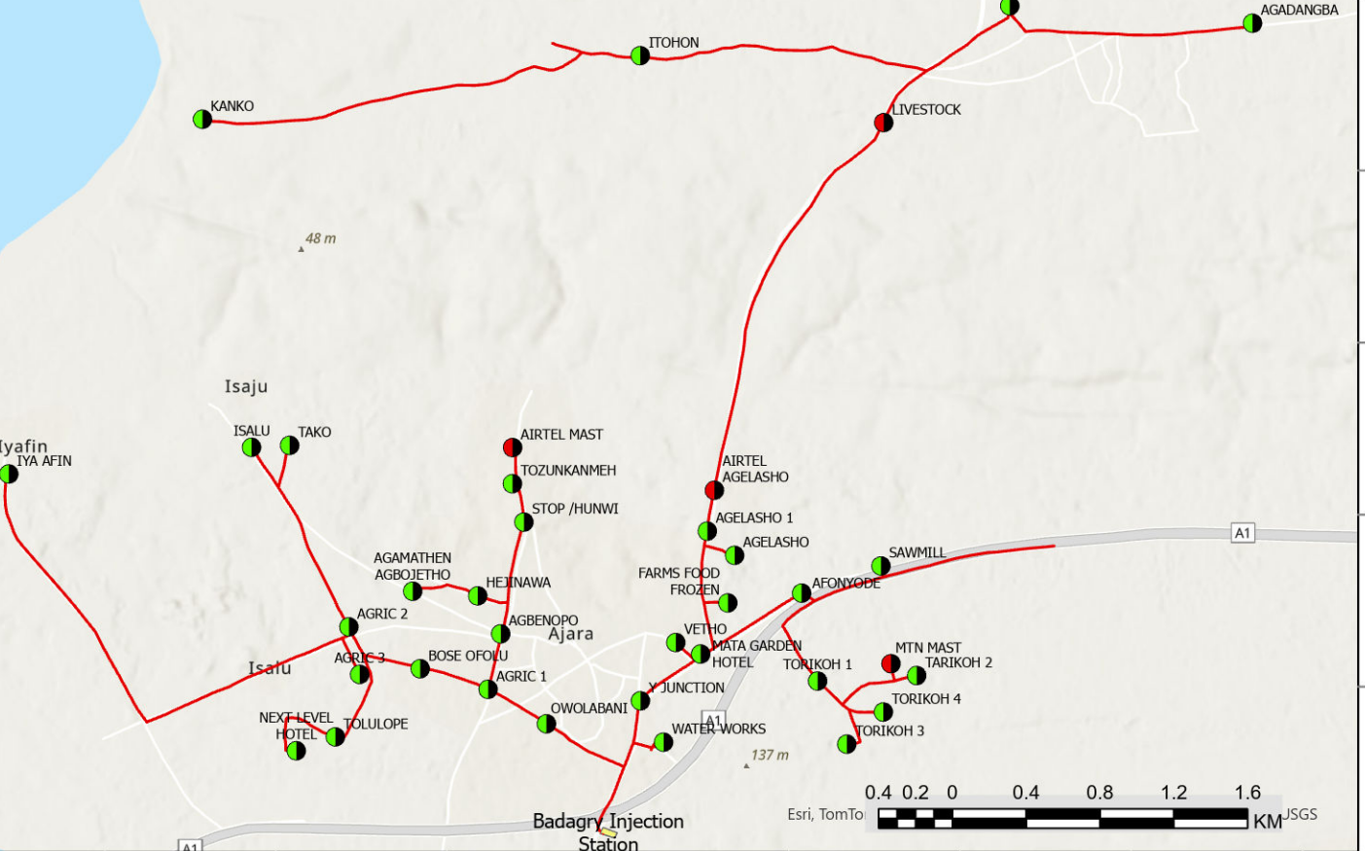
Overview of Cluster
S/N | DESCRIPTION | VALUE
1. | Average Hours of Supply | 7.8 Hours
2. | Number of Connections | 6,602
4. | Estimated Customer Population | 7,262
5. | Collection % (Jan-Jun 2024) | 65%
6. | Metering Penetration | 27%
7. | Average Monthly Collections | NGN21.50million
75%
25%
LOCATION: Ajara
RESIDENTIAL
ESTIMATED LOAD DEMAND: 4.1MW DAILY OAD: 2.8MW
COMMERCIAL & INDUSTRIAL
DISTRIBUTION INVESTMENT REQUIREMENT: NGN146.20million

Slide 30
Infrastructure
FAIR
STATE OF NETWORK
Top 3 Economic Activities
1. Retail Services
2. Crafts 3. Fishing & Farming
GOOD
ROAD ACCESSIBILITY
Feeder Route Length
25.6km
Voltage Level
11KV
Daily Load Profile
2.8 MWh
Installed Transformer Capacity
13.2MVA
GOOD
SECURITY STATUS
Network Limitations
Business Model
Franchising
NO
PIP FOCUSED AREA
Feeder rehabilitation required

Slide 31
BADAGRY 11

Slide 32
Overview of Cluster
S/N | DESCRIPTION | VALUE
1. | Average Hours of Supply | 8.1 Hours
2. | Number of Connections | 3,836
4. | Estimated Customer Population | 4,219
5. | Collection % (Jan-Jun 2024) | 65%
6. | Metering Penetration | 23%
7. | Average Monthly Collections | NGN13.55million
75%
25%
LOCATION: Badagry
RESIDENTIAL
ESTIMATED LOAD DEMAND: 3.2MW DAILY LOAD: 2.3MW
COMMERCIAL & INDUSTRIAL
DISTRIBUTION INVESTMENT REQUIREMENT: NGN92.17 million

Slide 33
Infrastructure
FAIR
STATE OF NETWORK
Top 3 Economic Activities
1. Retail Services
2. Crafts 3. Fishing & Farming
GOOD
ROAD ACCESSIBILITY
Feeder Route Length
16.3 km
Voltage Level
11KV
Daily Load Profile
2.3 MWh
Installed Transformer Capacity
15.05 MVA
GOOD
SECURITY STATUS
Network Limitations
Business Model
Franchising
NO
PIP FOCUSED AREA
Feeder rehabilitation required

Slide 34
Summary of EKEDP DER Pipeline
S/N | Project | Estimated Load Demand (MW) | Number of Connections | Average Monthly Collections (NGN) | Distribution Investment Required (NGN) | Installed Distribution Transformer Capacity (MVA) | Proposed Business Model
1 | Oko Afo | 28 MW | 36,196 | 80.15 million | 725.27million | 67.22 MVA | Franchising
2 | Otto Awori | 5.3 MW | 8,849 | 29.13 million | 169.27million | 22MVA | Franchising
3 | Eleko | 26 MW | 22,490 | 62.42 million | 160.75million | 160.75 MVA | Franchising
4 | Ijanikin | 5.8 MW | 7,362 | 21.09million | 18.85million | 18.85 MVA | Franchising
5 | Elemoro | 27 MW | 11,956 | 199.83million | 88.20million | 88.2 MVA | Franchising
6 | Ibeju | 24.8MW | 30,961 | 118.71 million | 106.60million | 106.6 MVA | Franchising
7 | Badagry 33 | 3.2 MW | 24,700 | 70.65 million | 69.83million | 69.83 MVA | Franchising
8 | Ogombo | 5.7 MW | 5,135 | 46.2 million | 27.65million | 27.65 MVA | Franchising
9. | Ajara | 3.2 MW | 6,602 | 21.50 million | 13.20million | 13.2 MVA | Franchising
10 | Badagry 11 | 3.2MW | 3,836 | 13.55 million | 15.05million | 15.05 MVA | Franchising

Slide 35
LIST OF UNSERVED AREAS IN EKEDP FRANCHISE
S/N | Project | Proposed Business Model
1 | Lekki Free Trade Zone | Franchising
2 | Across the Ocean | Franchising
3 | Eko Atlantic | Franchising
4 | Yegunda, Ibeju | Franchising
5 | Imuofo, Ibeju | Franchising
6 | Imuogu, Ibeju | Franchising
7 | Take, Ibeju | Franchising
8 | Igbo-Apawa, Ibeju | Franchising
9. | Ikotun, Ojo | Franchising
10 | Idoluwo, Ojo | Franchising
11 | Ibode, Ojo

Slide 36
THANK
YOU

