Slide 1

DER INVESTMENT OPPORTUNITIES
IN
ENUGU ELECTRICITY DISTRIBUTION PLC (EEDC)

Slide 2
Contents
1
2
3
4
About Us
Investment Opportunities
Board of Directors and Management
Next Steps
3
8
26
34

Slide 3
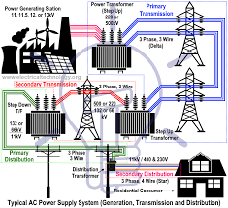


Slide 4
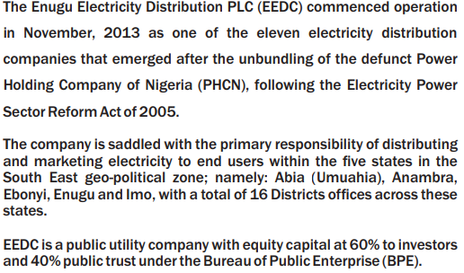
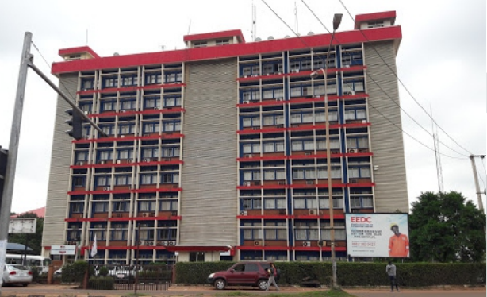

About Us

Slide 5
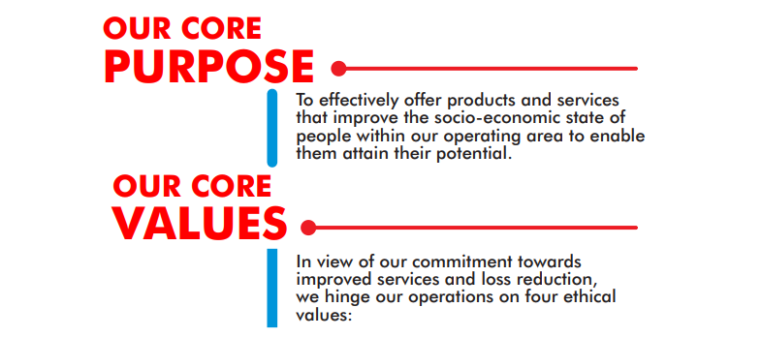

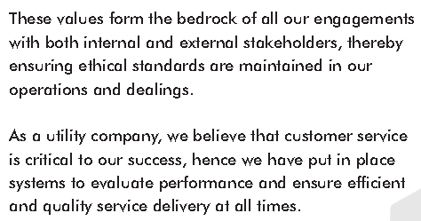

Slide 7

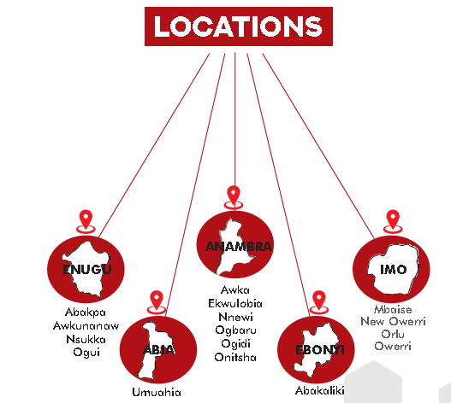
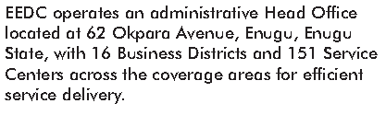

Slide 8



Slide 9

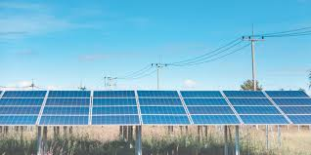
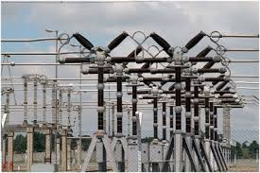
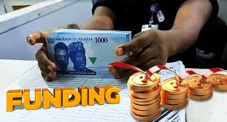
Business Model
Deepening Our Energy Mix and Improving Operational Efficiency
Interconnected Mini Grid
Embedded Generation
Franchising
Network Rehabilitation, Expansion and Distribution Network Management
Under-served
Unserved
Under-served Industrial Cluster
594 MW Portfolio
210 MW Portfolio
N158bn Investment

Slide 10
Situational Assessment
FRANCHISING
Energy Theft
Decrepit Network Infrastructure
Liquidity Challenge
Inadequate Metering
Poor Quality Services
Poor Collection
EMBEDDED GENERATION
CAPACITY CONSTRAINT
POOR RELIABILITY INDEX
UNDERSERVED LOAD
SUPPRESSED LOAD
Interconnected Mini Grid
Poor Power Supply/Low Revenue
Poor LV Reticulation
Poor Meter Penetration
Obsolete/Faulty Equipment

Slide 11
Investment Case: Interconnected Mini-Grid (District Wise)
Ogui -24MW
Abakpa -58MW
Awkunanaw -72MW
Nsukka -30MW
Awka -45MW
Ekwulobia -35MW
Ogbaru -9MW
Ogidi -31MW
Nnwi -58MW
Onitsha -26MW
Orlu -68MW
Owerri -30MW
New Owerri -30MW
Mbaise -29MW
Abakaliki -24MW
Umuahia -25MW

Slide 12
Investment Case: Franchising (Feeder Wise)
No of Feeders
Service Band
Average Collection
Average Loss Level
Owerri District -Imo
12 Feeders
New Owerri District
7 Feeders
Mbaise District -Imo
10 feeders
Orlu District -Imo
15 Feeders
Band C
30.63bn
42%
Band C
N37.63
28%
Band E
N0.7bn
47%
Band E
N1.05bn
91%
Approach of Franchising
Metering, Billing, and Collection
Total management of electricity distribution function in a ring-fenced area
Total management of distribution feeders including billing & collection.
Loss reduction and provision of embedded generation

Slide 13
Investment Case: Franchising Cont’d
No of Feeders
Service Band
Average Collection
Average Loss Level
Awka District -Anambra
19 Feeders
Abakaliki
District -Ebonyi
19 Feeders
Onitsha District -Anambra
10 feeders
Ekwulobia District -Anambra
15 Feeders
Band C
N531.6m
36%
Band C
N454.7m
52%
Band C
N489.15m
42%
Band E
N218.8m
51%
Approach of Franchising
Metering, Billing, and Collection
Total management of electricity distribution function in a ring-fenced area
Total management of distribution feeders including billing & collection.
Loss reduction and provision of embedded generation

Slide 14
Investment Case: Franchising Cont’d
No of Feeders
Service Band
Average Collection
Average Loss Level
Umuahia District -Abia
1 Feeders
Nnewi
District -Anamabra
9 Feeders
Awkunanaw District -Enugu
7 feeders
Ogui District -Enugu
15 Feeders
Band C
N209.87m
36%
Band C
N198.9m
50%
Band C
N393m
51%
Band C
N790.8m
46%
Approach of Franchising
Metering, Billing, and Collection
Total management of electricity distribution function in a ring-fenced area
Total management of distribution feeders including billing & collection.
Loss reduction and provision of embedded generation

Slide 15
Investment Case: Franchising Cont’d
No of Feeders
Service Band
Average Collection
Average Loss Level
Nsukka District -Enugu
1 Feeders
Abakpa
District -Enugu
13 Feeders
Band C
N532.4m
29%
Band C
N1.078bn
43%
Approach of Franchising
Metering, Billing, and Collection
Total management of electricity distribution function in a ring-fenced area
Total management of distribution feeders including billing & collection.
Loss reduction and provision of embedded generation

Slide 16
Investment Case: Embedded Generation (Industrial Clusters)
Ogbaru Industrial Cluster
Ogbaru Industrial Estate
Anambra State
30 MW
15 MW
Nnewi Industrial / Commercial Hub
Ichi, Oba, and Nnewi
Anambra State
Akwudo Injection sub Station
Uruagu, Nnewi
Anambra State
40 MW
30 MW
Egbu Rd Injection Sub Station
Mbaise Rd, Owerri
Imo State State

Slide 17
Investment Case: Embedded Generation Cont’d
Onitsha Rd Injection Sub Station
Owerri-Onitsha Express Rd Owerri
Imo State
18 MW
40 MW
New Owerri Injection Sub Station
Concord Rd New Owerri
Imo State
CBN Leg 33KV commercial Hub
New Owerri
Imo State
10 MW
8 MW
Owerri 3-33Kv Commercial Hub
Naze Rd, New Owerri
Imo State

Slide 18
Investment Case: Embedded Generation Cont’d
Ezeagu Industrial Cluster
Ezeagu(Along Enugu-Osha Express Way
Enugu State
3 MW
4 MW
9Th Mile 11KV Industrial Cluster
Enugu North
Enugu State

Slide 19


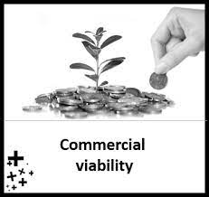


Our Approach/methodology: Project lifecycle screening criteria
Funding
guarantee
Commercial viability
Financing structure
Risk mitigation
Government, IDA, MIGA,
(De-risk projects to attract private sector financing), ‘No drawing of big money to big black holes.’
Private Sector Financing
Vendor Financing
Joint Venture
Debt/Equity (Hybrid)
Positive NPV,
High IRR, ROI, Short-time PBP
Foreign Currency, Local Currency, Project Optimal Capital Structure
Contractual Structuring: Technical, Financial and Legal Due diligence,
Appropriate Risk Allocation & Pricing

Slide 20
Value Propositions: Providing integrated Project financing schema
Projects Feasibility: (Achieving economic and development goals
Project Identification, Assessment & Preparation)
Projects Bankability: (Extracting value for money, ensuring financial viability & market sounding)
Projects Structuring: (Long-term sustainability, environmental protection & Safety)
Risk Mitigation/Active Credit Market:
Risk Assessment, Allocation & Monitoring
Capacity Development: (Vibrant power & electricity market)

Slide 21
Our Investment De-risking Strategies
Pay-and-Use Model (100% metering with prepaid smart meters to minimize cash flow variability)
Ring-fencing Project Cashflows
Leveraging Concessional (below market rate)
Finance and guarantee from World Bank and other multilateral institutions to scale up investment in renewables
Leveraging regulatory reforms and support especially from NERC
Strengthening Stakeholders and strategic partners collaboration

Slide 22


Expected Outcomes
Remove capacity constraint and onboard suppressed load
Reduce Loss Level to a single digit
Revenue growth and collection efficiency
Increase economic and social opportunities
Customer Satisfaction (Enhanced reliability and quality Services)

Slide 23

Challenges
Project Bankability
Unhealth Environment (Poor governance)
Insecurity
Uncertainties

Slide 24




Sustainability is at the heart of everything we do!

Slide 25

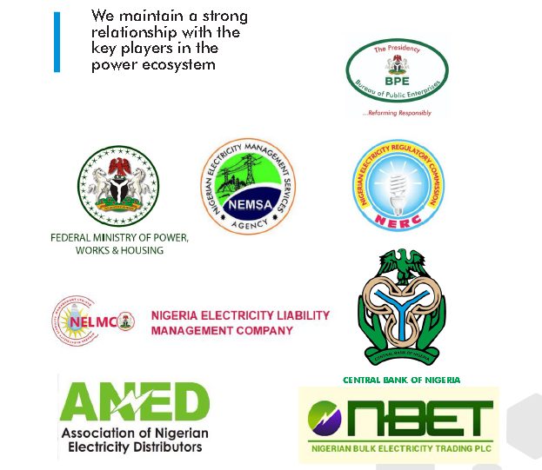
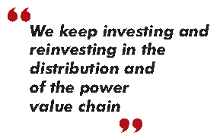

Slide 26

Board of Directors and
Management

Slide 27

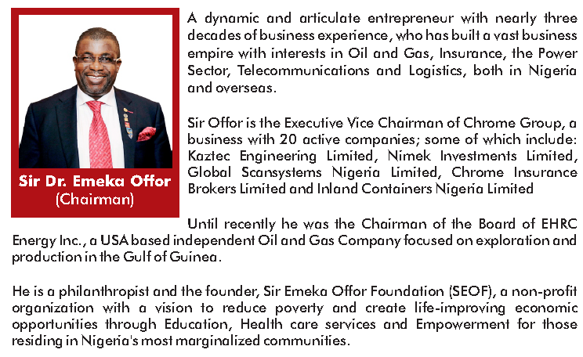
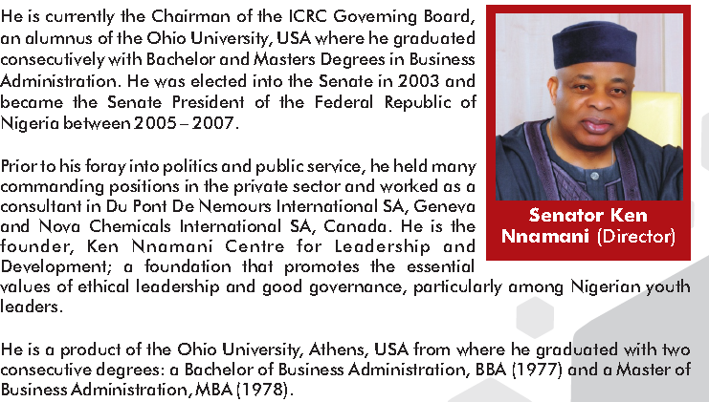

Slide 28
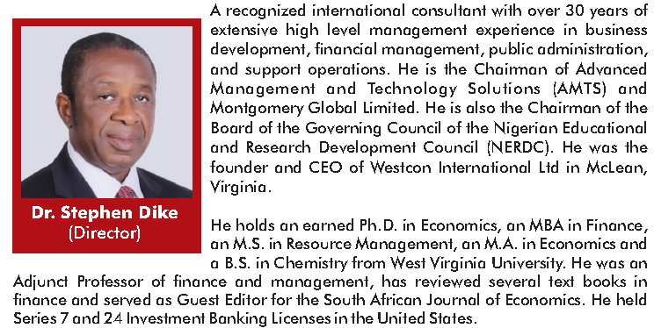
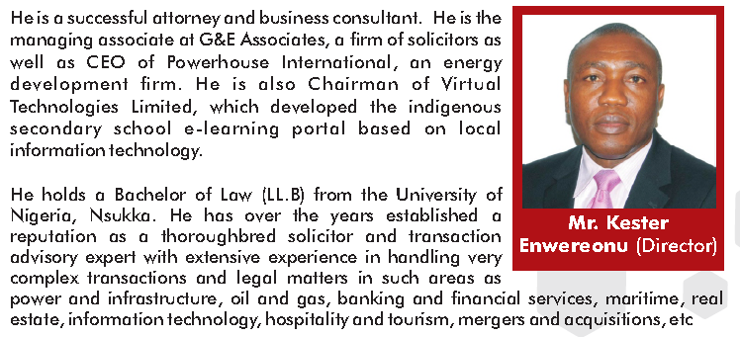

Slide 29

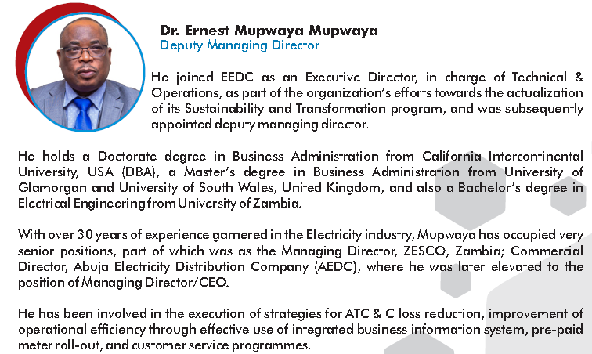
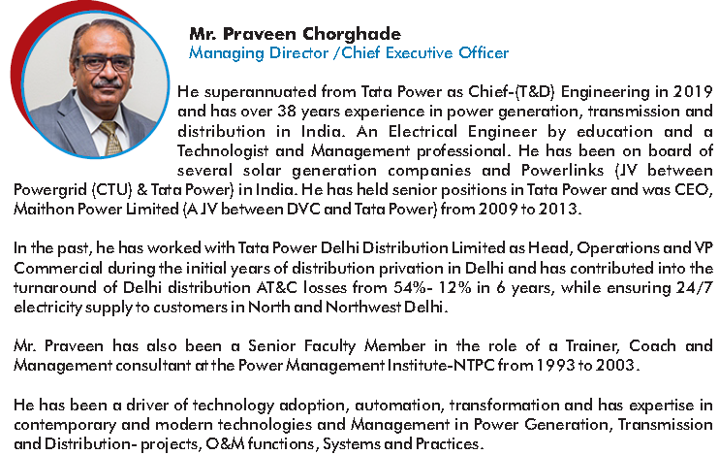

Slide 30
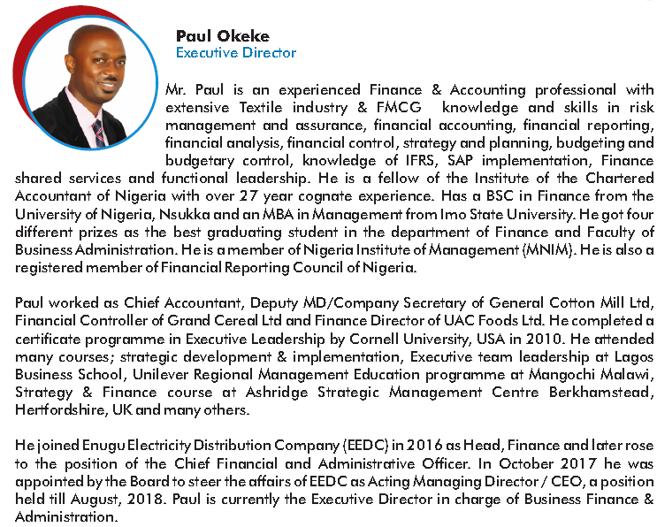

Slide 31
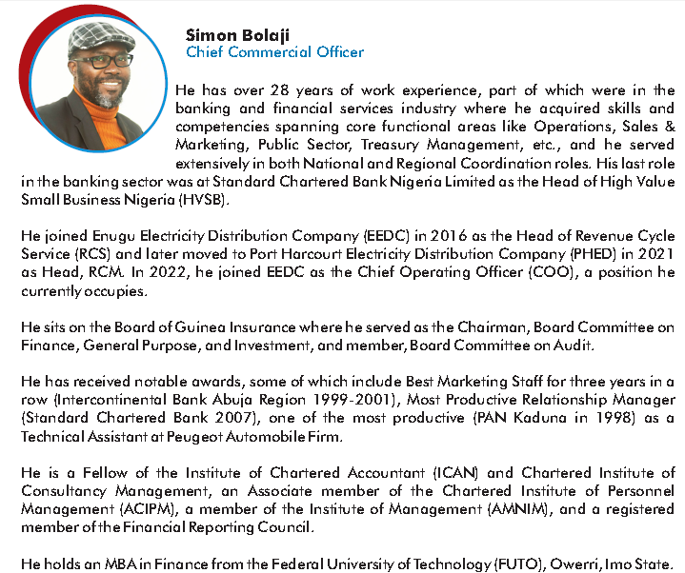
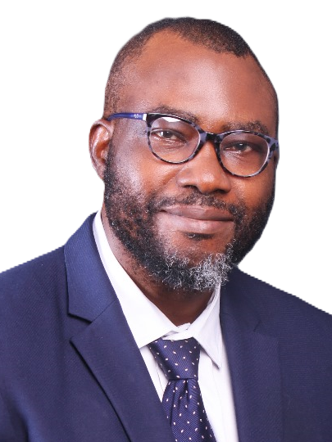
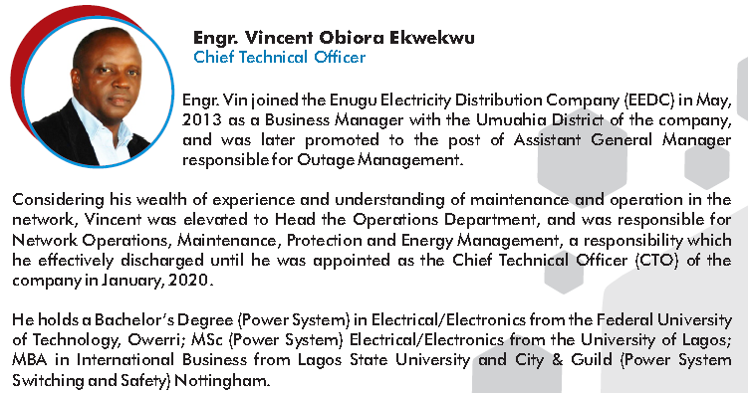

Slide 32
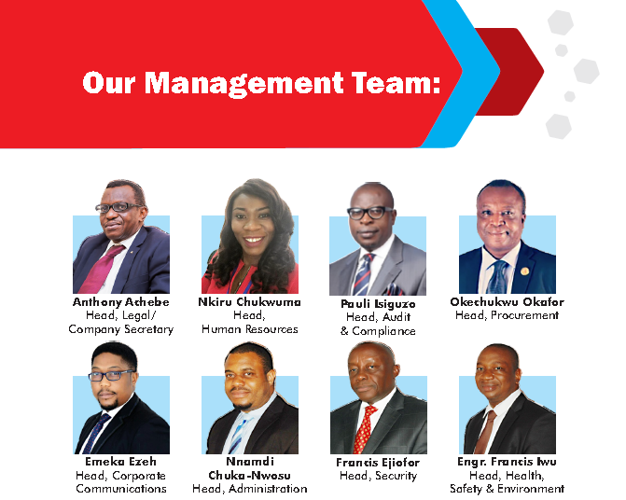
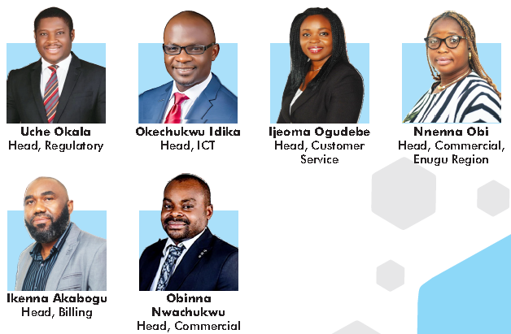
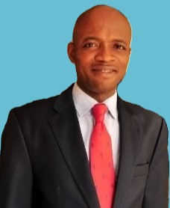
Modestus Onuoha
Head, Corporate Finance

Slide 33
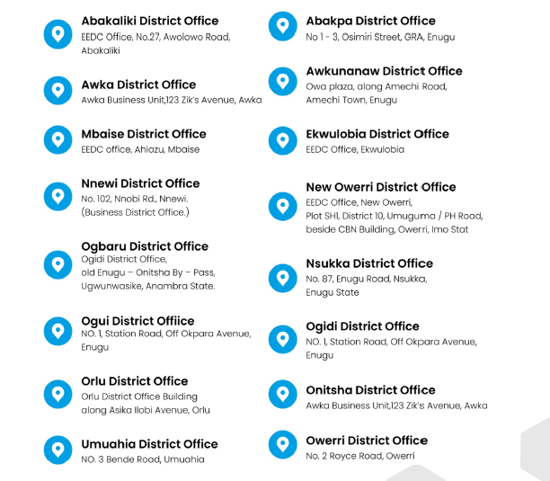


Slide 34



Slide 35

Next Step
NDA Execution
Due diligence
(Combining both hard analysis and soft approach)
Binding Offer
Project Execution
Project Commission

Slide 36
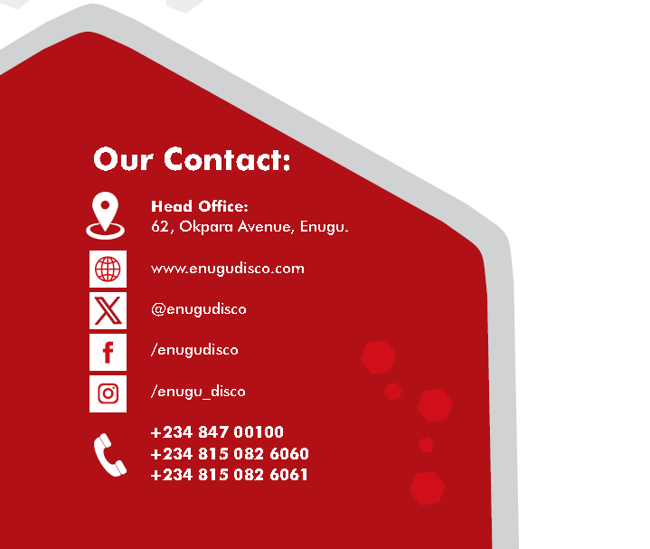
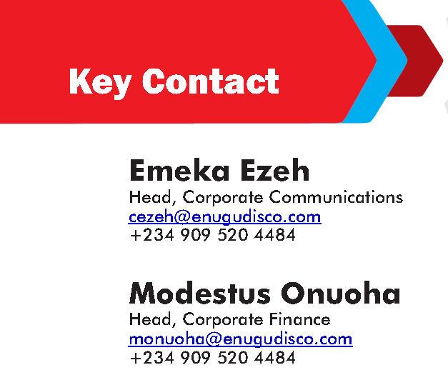
Augustine Anagor
Assistant Manager, System Planning
aanagor@enugudisco.com
234 815 082 4488
Chike Obika
Assistant Manager, System Planning
cobika@enugudisco.com
234 815 082 4318
Modestus Onuoha
Head, Corporate Finance
monuoha@enugudisco.com
234 815 082 6340

