Slide 1
ABUJA ELECTRICITY DISTRIBUTION COMPANY
DER OPPORTUNITIES
ABUJA ELECTRICITY DISTRIBUTION PLC
PRESENTATION

Slide 2
DISCO PROFILE
Abuja Electricity Distribution Plc (AEDC)
AEDC is Nigeria’s 3rd largest Distribution Company (Disco) and distributes electricity across the Federal Capital Territory and the following Staes: Niger, Nasarawa and Kogi.
AEDC has reduced ATC&C losses since privatization from 60% to [39]% and increased monthly cash collection from N2bn in 2013 to N23bn currently.
AEDC has supported utility-led distributed energy resources (DER) since 2019 and has demonstrated its commitment through the successful implementation of the following projects:
1MW Interconnected Mini-Grid – Wuse Market
0.35MW Interconnected Mini-Grid – Toto community
0.6MW Hybrid Commercial & Industrial (C&I) project
The company has a strong DER pipeline with a combined capacity of 100MW and is seeking collaboration with developers and investors.

Slide 3
IDU – EMBEDDED GENERATION PROJECT

Slide 4
Idu Industrial Area EG Project
Large
Industrial Cluster
Idu is an industrial town located in Abuja, in the eastern part of the Federal Capital Territory. It is within 10km from the Abuja City Center and it has an area of ~28.7 km².
It is a major industrial cluster in Abuja including manufacturing, construction, offices, warehouses, medical and educational facilities, etc.
Embedded Generation Plant
AEDC is signing a Power Purchase Agreement with TransAfam Power to build a 50MW Embedded Generation gas plant in the cluster.
This is to cater to the needs of these industrial customers by ensuring available and reliable power supply for productive uses.
Improved supply by the reliance on the 50MW Embedded Generation gas plant as primary source of supply to the industrial area.
Reliable Supply
Network Reliability
Revamp of aged HT and LT Network
Metering of DT for energy and outage information
Preventive maintenance teams & night patrolling squads
Turn-around timelines for faster restoration of outages

Slide 5
FEEDER A

Slide 6
Overview of Cluster
S/N | DESCRIPTION | VALUE
1. | Average Hours of Supply | 12 Hours
2. | Number of Connections | 2,486
3. | ATC&C Loss | %
4. | Metering Penetration | 83%
5. | Average Monthly Collections | NGN16 million
LOCATION: Kubwa, FCT
ESTIMATED LOAD DEMAND: 3MW
DISTRIBUTION INVESTMENT REQUIREMENT: NGN 16 million
92%
8%
RESIDENTIAL
COMMERCIAL & INDUSTRIAL

Slide 7
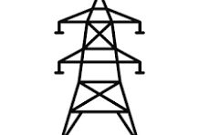
Infrastructure
FAIR
STATE OF NETWORK
Top 3 Economic Activities
1. Retail Services
2. Manufacturing
3. Supermarkets
GOOD
ROAD ACCESSIBILITY
Feeder Route Length
4.5km
Voltage Level
11KV
Daily Load Profile
72MWh
Installed Transformer Capacity
21000KVA
GOOD
SECURITY STATUS
Network Limitations
Business Model
Franchising
NO
PIP FOCUSED AREA
There are transmission bottlenecks on the feeder resulting in poor supply.

Slide 8
FEEDER B

Slide 9
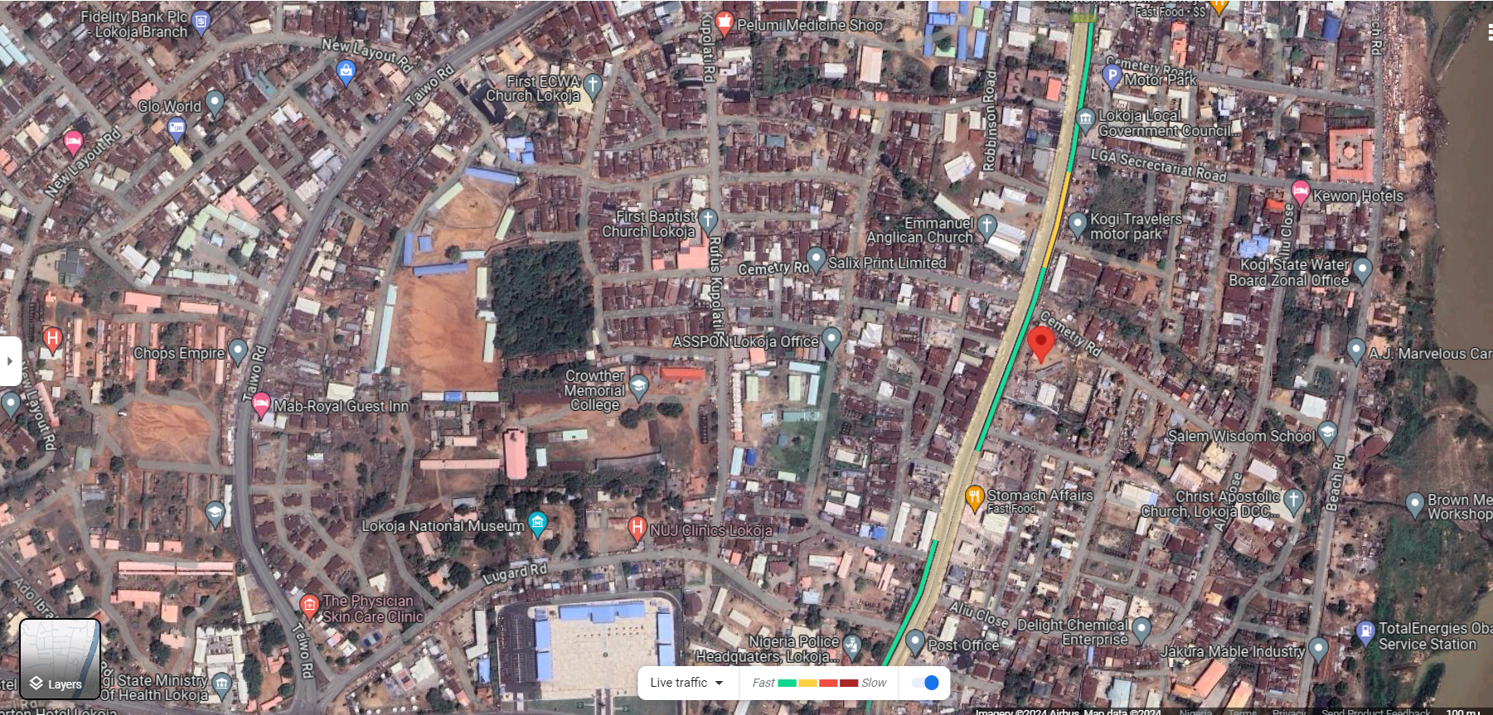
Overview of Cluster
S/N | DESCRIPTION | VALUE
1. | Average Hours of Supply | 12 Hours
2. | Number of Connections | 3,000
3. | ATC&C Loss | 54%
4. | Metering Penetration | 5%
5. | Average Monthly Collections | NGN5 million
LOCATION: Lokoja, Kogi
ESTIMATED LOAD DEMAND: 6.7MW
DISTRIBUTION INVESTMENT REQUIREMENT: NGN 55 million
97%
3%
RESIDENTIAL
COMMERCIAL & INDUSTRIAL

Slide 10
Infrastructure
FAIR
STATE OF NETWORK
Top 3 Economic Activities
1. Fishing
2. Agriculture
3. Mining
GOOD
ROAD ACCESSIBILITY
Feeder Route Length
115km
Voltage Level
11KV
Daily Load Profile
160.80MWh
Installed Transformer Capacity
36000KVA
GOOD
SECURITY STATUS
Network Limitations
Business Model
Franchising
NO
PIP FOCUSED AREA
There are transmission bottlenecks on the feeder resulting in poor supply.

Slide 11
FEEDER C

Slide 12
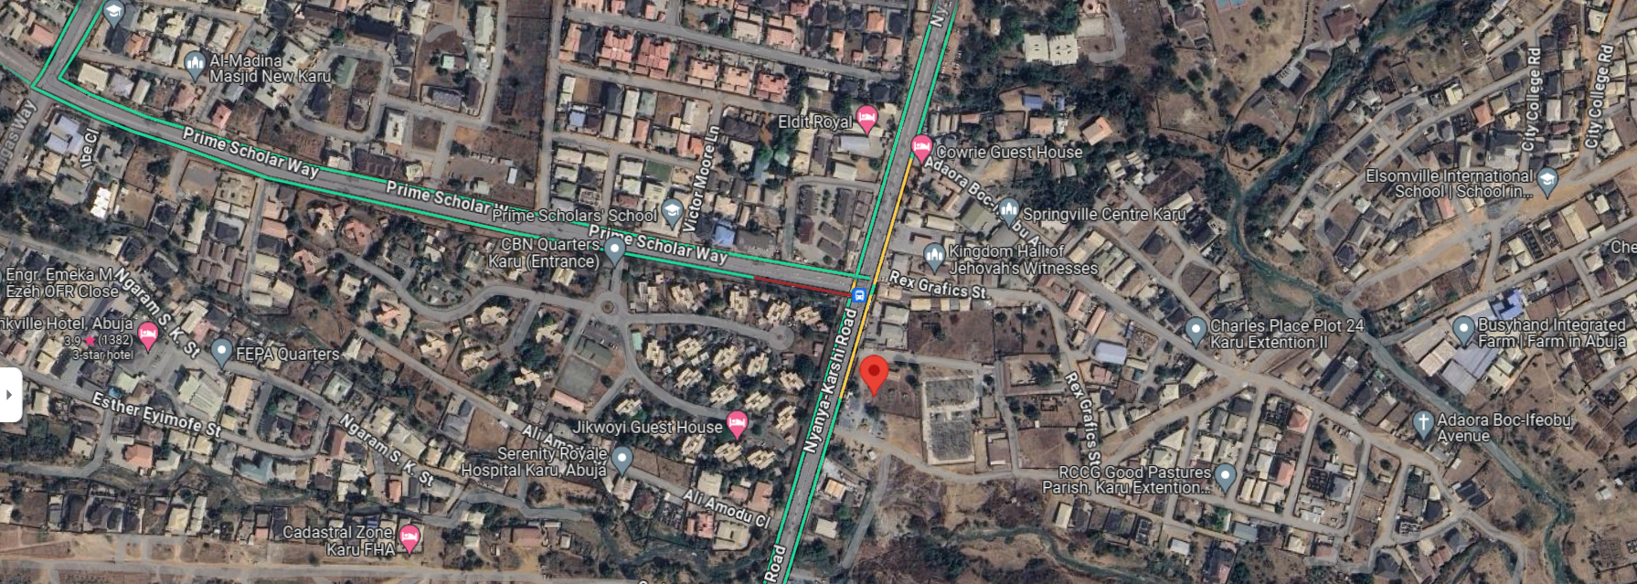
Overview of Cluster
S/N | DESCRIPTION | VALUE
1. | Average Hours of Supply | 15 Hours
2. | Number of Connections | 120
3. | ATC&C Loss | 6%
4. | Metering Penetration | 96%
5. | Average Monthly Collections | NGN7 million
LOCATION: Karu, FCT
ESTIMATED LOAD DEMAND: 0.2MW
DISTRIBUTION INVESTMENT REQUIREMENT: NGN 4 million
88%
12%
RESIDENTIAL
COMMERCIAL & INDUSTRIAL

Slide 13
Infrastructure
FAIR
STATE OF NETWORK
Top 3 Economic Activities
1. Retail Services
2. Small scale production
3. Bakeries
GOOD
ROAD ACCESSIBILITY
Feeder Route Length
5.7km
Voltage Level
11KV
Daily Load Profile
4.8MWh
Installed Transformer Capacity
1700KVA
GOOD
SECURITY STATUS
Network Limitations
Business Model
Embedded Generation
NO
PIP FOCUSED AREA
There are transmission bottlenecks on the feeder resulting in poor supply.

Slide 14
FEEDER D

Slide 15
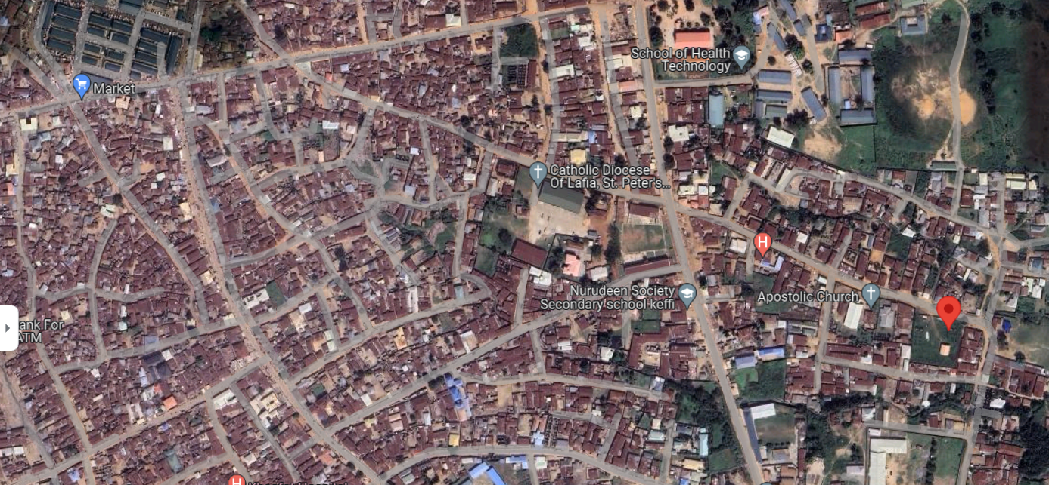
Overview of Cluster
S/N | DESCRIPTION | VALUE
1. | Average Hours of Supply | 9 Hours
2. | Number of Connections | 4,741
3. | ATC&C Loss | 59%
4. | Metering Penetration | 38%
5. | Average Monthly Collections | NGN18 million
LOCATION: Keffi, Nasarawa
ESTIMATED LOAD DEMAND: 5.03MW
DISTRIBUTION INVESTMENT REQUIREMENT: NGN 105 million
94%
6%
RESIDENTIAL
COMMERCIAL & INDUSTRIAL

Slide 16
Infrastructure
FAIR
STATE OF NETWORK
Top 3 Economic Activities
1. Agriculture
2. Retail Services
3. Medium scale Production
GOOD
ROAD ACCESSIBILITY
Feeder Route Length
33km
Voltage Level
11KV
Daily Load Profile
120.72MWh
Installed Transformer Capacity
27000KVA
GOOD
SECURITY STATUS
Network Limitations
Business Model
Franchising
NO
PIP FOCUSED AREA
There are transmission bottlenecks on the feeder resulting in poor supply.

Slide 17
FEEDER E

Slide 18
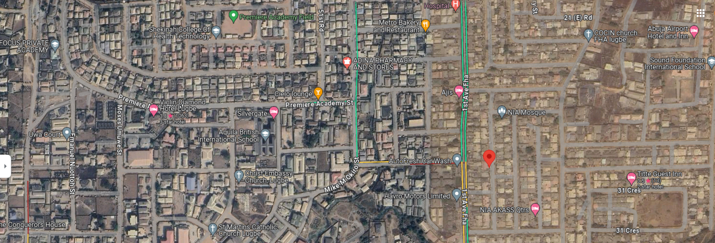
Overview of Cluster
S/N | DESCRIPTION | VALUE
1. | Average Hours of Supply | 12 Hours
2. | Number of Connections | 5,645
3. | ATC&C Loss | 38%
4. | Metering Penetration | 93%
5. | Average Monthly Collections | NGN16 million
LOCATION: Lugbe, FCT
ESTIMATED LOAD DEMAND: 5.19MW
DISTRIBUTION INVESTMENT REQUIREMENT: NGN million
89%
11%
RESIDENTIAL
COMMERCIAL & INDUSTRIAL

Slide 19
Infrastructure
FAIR
STATE OF NETWORK
Top 3 Economic Activities
1. Retail Services
2. Supermarkets
3. Block making Industries
GOOD
ROAD ACCESSIBILITY
Feeder Route Length
20km
Voltage Level
11KV
Daily Load Profile
124.56MWh
Installed Transformer Capacity
2200KVA
GOOD
SECURITY STATUS
Network Limitations
Business Model
Embedded Generation
NO
PIP FOCUSED AREA
There are transmission bottlenecks on the feeder resulting in poor supply.

Slide 20
FEEDER F

Slide 21
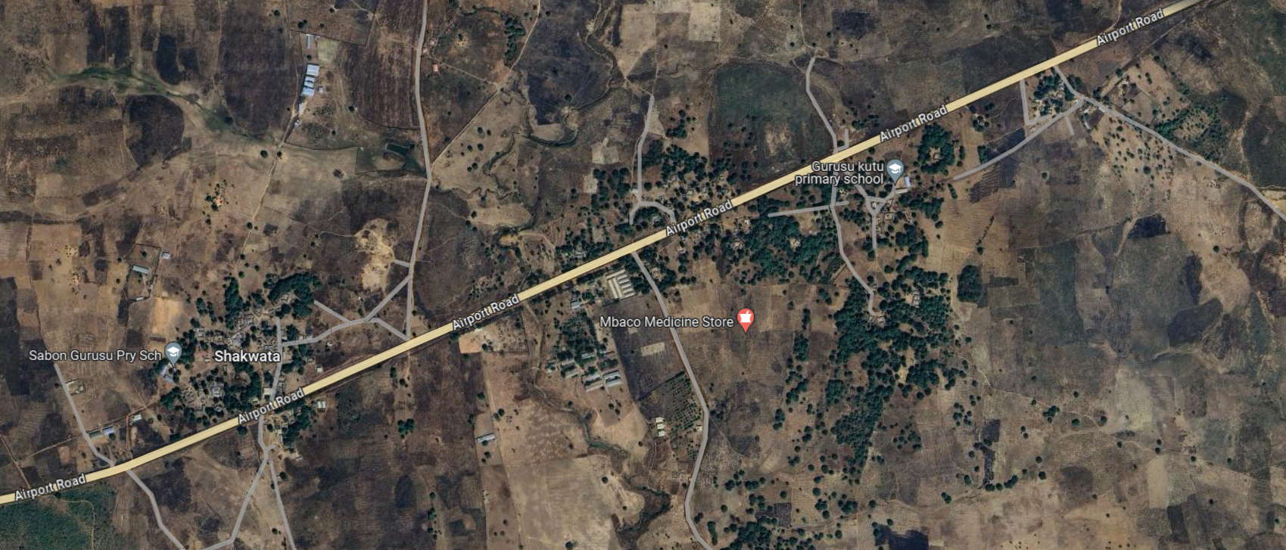
Overview of Cluster
S/N | DESCRIPTION | VALUE
1. | Average Hours of Supply | 12 Hours
2. | Number of Connections | 398
3. | ATC&C Loss | 99%
4. | Metering Penetration | 84%
5. | Average Monthly Collections | NGN4 million
LOCATION: Minna, Niger
ESTIMATED LOAD DEMAND: 4MW
DISTRIBUTION INVESTMENT REQUIREMENT: NGN 16 million
85%
15%
RESIDENTIAL
COMMERCIAL & INDUSTRIAL

Slide 22
Infrastructure
FAIR
STATE OF NETWORK
Top 3 Economic Activities
1. Brick-making plants
2. Agriculture
3. Food & Beverage Service
GOOD
ROAD ACCESSIBILITY
Feeder Route Length
15.25km
Voltage Level
11KV
Daily Load Profile
96MWh
Installed Transformer Capacity
13650KVA
GOOD
SECURITY STATUS
Network Limitations
Business Model
Franchising
NO
PIP FOCUSED AREA
There are transmission bottlenecks on the feeder resulting in poor supply.

Slide 23
FEEDER G

Slide 24
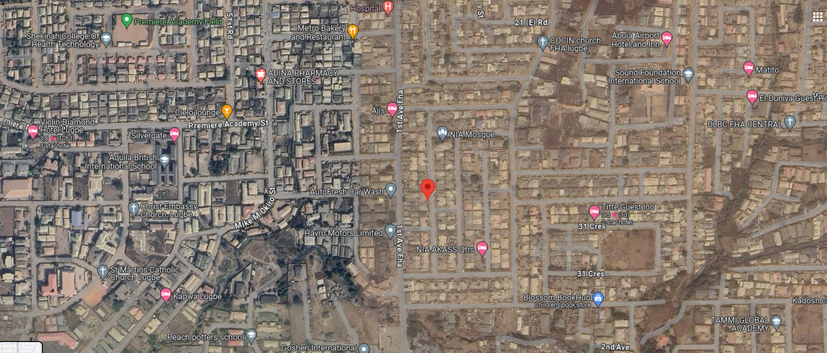
Overview of Cluster
S/N | DESCRIPTION | VALUE
1. | Average Hours of Supply | 12 Hours
2. | Number of Connections | 979
3. | ATC&C Loss | 81%
4. | Metering Penetration | 28%
5. | Average Monthly Collections | NGN16 million
LOCATION: Lugbe, FCT
ESTIMATED LOAD DEMAND: 4.28MW
DISTRIBUTION INVESTMENT REQUIREMENT: NGN million
92%
8%
RESIDENTIAL
COMMERCIAL & INDUSTRIAL

Slide 25
Infrastructure
FAIR
STATE OF NETWORK
Top 3 Economic Activities
1. Retail Services
2. Supermarkets
3. Block making Industries
GOOD
ROAD ACCESSIBILITY
Feeder Route Length
42km
Voltage Level
11KV
Daily Load Profile
102.72MWh
Installed Transformer Capacity
32450KVA
GOOD
SECURITY STATUS
Network Limitations
Business Model
Franchising
NO
PIP FOCUSED AREA
There are transmission bottlenecks on the feeder resulting in poor supply.

Slide 26
FEEDER H

Slide 27
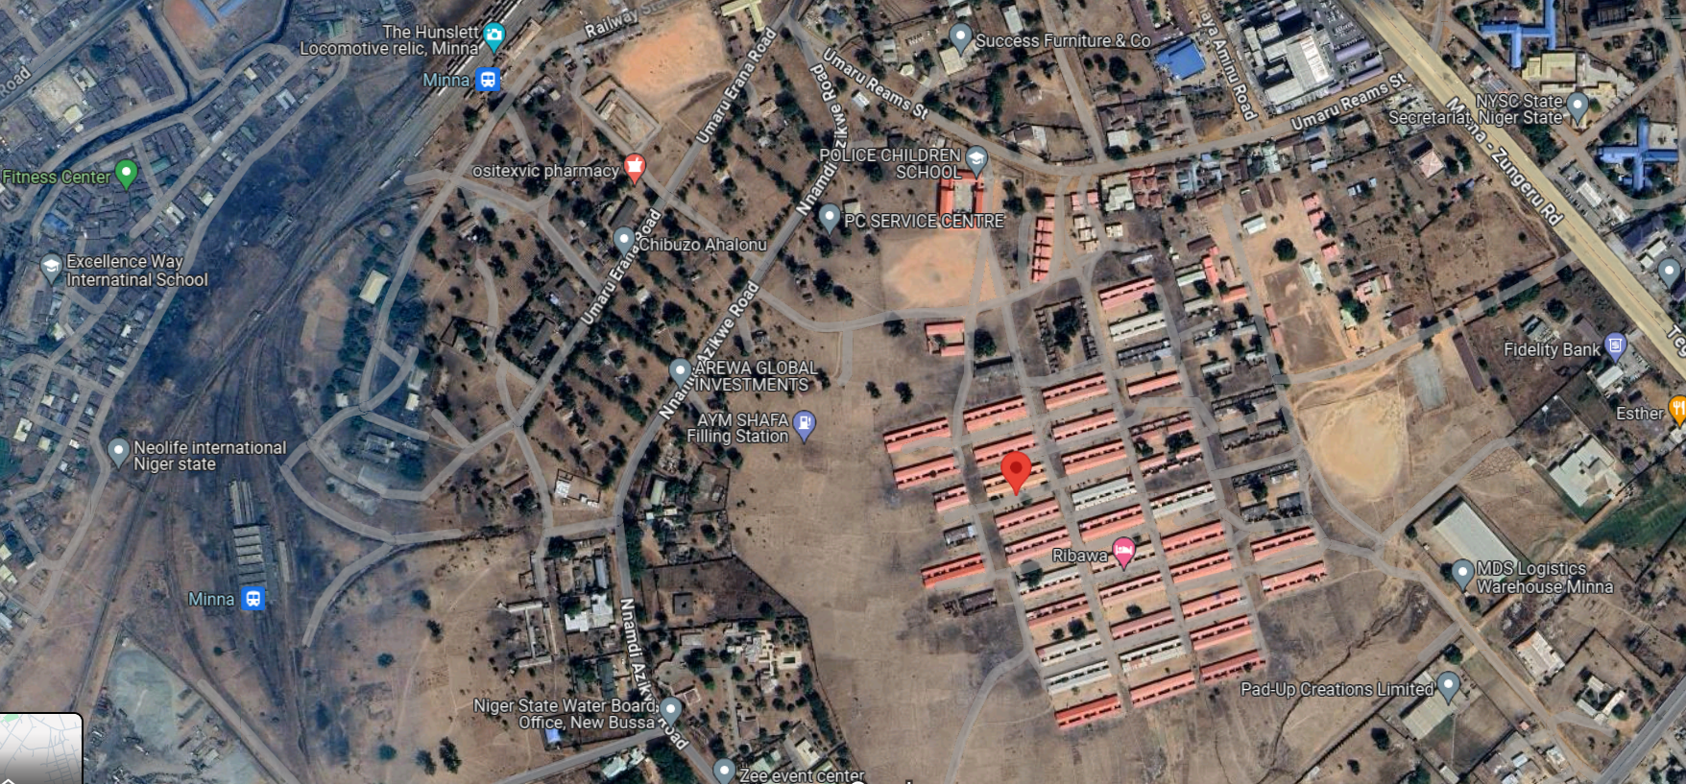
Overview of Cluster
S/N | DESCRIPTION | VALUE
1. | Average Hours of Supply | 8 Hours
2. | Number of Connections | 2,038
3. | ATC&C Loss | 95%
4. | Metering Penetration | 28%
5. | Average Monthly Collections | NGN13 million
LOCATION: Minna, Niger
ESTIMATED LOAD DEMAND: 2.3MW
DISTRIBUTION INVESTMENT REQUIREMENT: NGN 22 million
87%
13%
RESIDENTIAL
COMMERCIAL & INDUSTRIAL

Slide 28
Infrastructure
FAIR
STATE OF NETWORK
Top 3 Economic Activities
1. Food processing
2. Agriculture - Farming
3. Food & Beverage Service
GOOD
ROAD ACCESSIBILITY
Feeder Route Length
8.3km
Voltage Level
11KV
Daily Load Profile
55.20MWh
Installed Transformer Capacity
14200KVA
GOOD
SECURITY STATUS
Network Limitations
Business Model
Franchising
NO
PIP FOCUSED AREA
There are transmission bottlenecks on the feeder resulting in poor supply.

Slide 29
FEEDER I

Slide 30
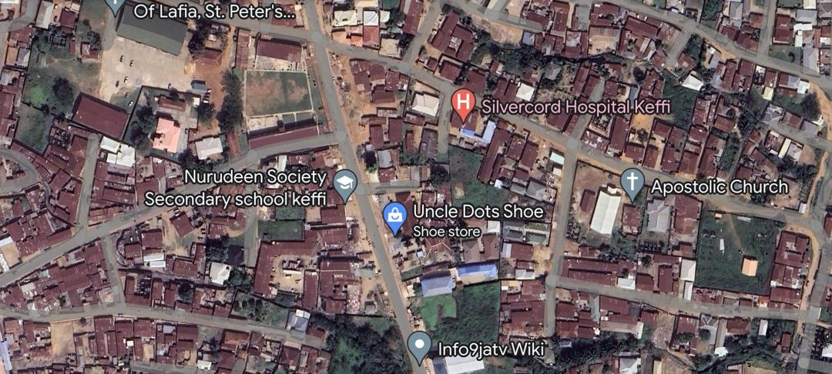
Overview of Cluster
S/N | DESCRIPTION | VALUE
1. | Average Hours of Supply | 9 Hours
2. | Number of Connections | 3,496
4. | Estimated Customer Population | -
5. | ATC&C Loss | 66%
6. | Metering Penetration | 25%
7. | Average Monthly Collections | NGN20 million
LOCATION: Keffi, Nasarawa
ESTIMATED LOAD DEMAND: 5.68MW
DISTRIBUTION INVESTMENT REQUIREMENT: NGN 75 million
90%
10%
RESIDENTIAL
COMMERCIAL & INDUSTRIAL

Slide 31
Infrastructure
FAIR
STATE OF NETWORK
Top 3 Economic Activities
1. Agriculture
2. Retail services
3. Food & Beverage
GOOD
ROAD ACCESSIBILITY
Feeder Route Length
22.3km
Voltage Level
11KV
Daily Load Profile
136.32MWh
Installed Transformer Capacity
23050KVA
GOOD
SECURITY STATUS
Network Limitations
Business Model
Franchising
NO
PIP FOCUSED AREA
There are transmission bottlenecks on the feeder resulting in poor supply.

Slide 32
FEEDER J

Slide 33
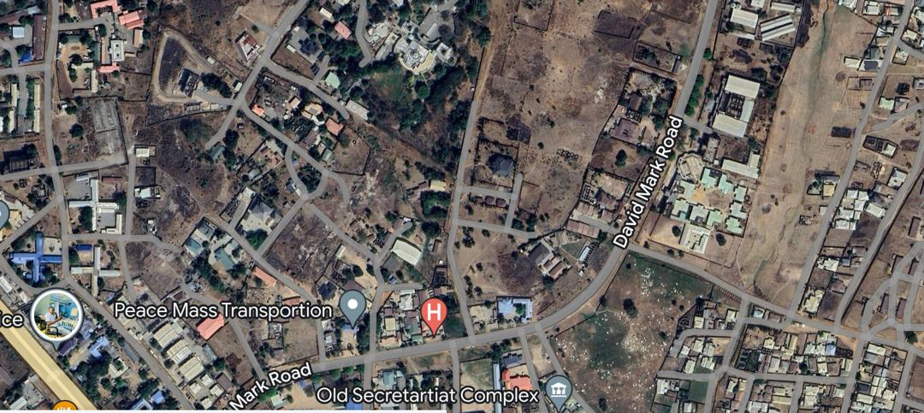
Overview of Cluster
S/N | DESCRIPTION | VALUE
1. | Average Hours of Supply | 8 Hours
2. | Number of Connections | 7,025
3. | ATC&C Loss | 82%
4. | Metering Penetration | 25%
5. | Average Monthly Collections | NGN 69 million
LOCATION: Minna, Niger
ESTIMATED LOAD DEMAND: 5.3MW
DISTRIBUTION INVESTMENT REQUIREMENT: NGN 50 million
90%
10%
RESIDENTIAL
COMMERCIAL & INDUSTRIAL

Slide 34
Infrastructure
FAIR
STATE OF NETWORK
Top 3 Economic Activities
1. Brick-making plants
2. Agriculture
3. Food Processing Services
GOOD
ROAD ACCESSIBILITY
Feeder Route Length
33.24km
Voltage Level
11KV
Daily Load Profile
127.20MWh
Installed Transformer Capacity
21500KVA
GOOD
SECURITY STATUS
Network Limitations
Business Model
Franchising
NO
PIP FOCUSED AREA
There are transmission bottlenecks on the feeder resulting in poor supply.

Slide 35
FEEDER K

Slide 36
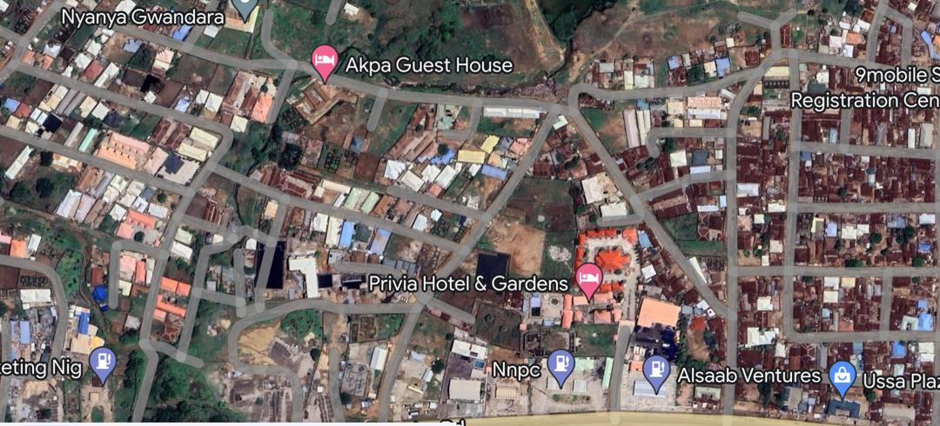
Overview of Cluster
S/N | DESCRIPTION | VALUE
1. | Average Hours of Supply | 6 Hours
2. | Number of Connections | 6,296
3. | ATC&C Loss | 37%
4. | Metering Penetration | 18%
5. | Average Monthly Collections | NGN 4 million
LOCATION: Ado, Nasarawa
ESTIMATED LOAD DEMAND: 1.3MW
DISTRIBUTION INVESTMENT REQUIREMENT: NGN 64 million
88%
12%
RESIDENTIAL
COMMERCIAL & INDUSTRIAL

Slide 37
Infrastructure
FAIR
STATE OF NETWORK
Top 3 Economic Activities
1. Retail Services
2. Local Markets
3. Fuel depots
GOOD
ROAD ACCESSIBILITY
Feeder Route Length
6.2km
Voltage Level
11KV
Daily Load Profile
31.20MWh
Installed Transformer Capacity
7000KVA
GOOD
SECURITY STATUS
Network Limitations
Business Model
Embedded Generation
NO
PIP FOCUSED AREA
There are transmission bottlenecks on the feeder resulting in poor supply.

Slide 38
FEEDER L

Slide 39
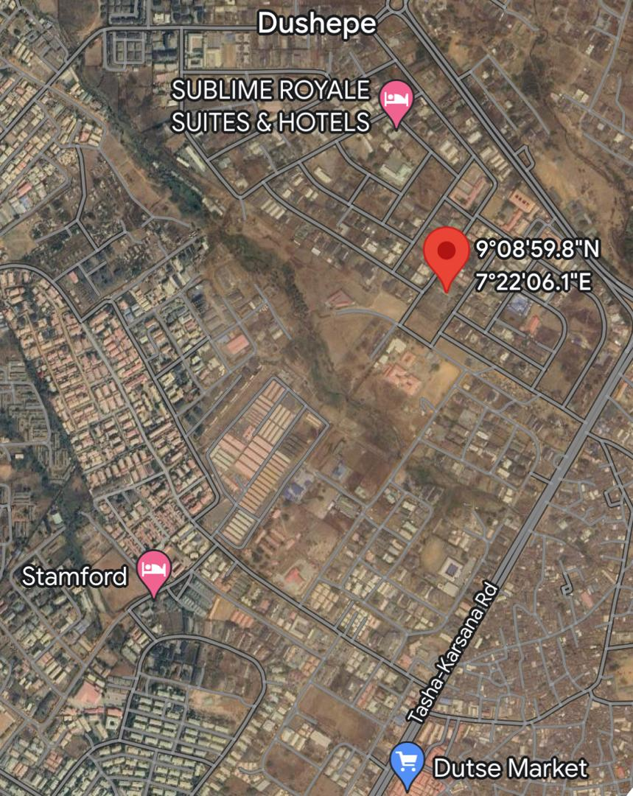
Overview of Cluster
S/N | DESCRIPTION | VALUE
1. | Average Hours of Supply | 16 Hours
2. | Number of Connections | 4,136
3. | ATC&C Loss | 21%
4. | Metering Penetration | 75%
5. | Average Monthly Collections | NGN 18 million
LOCATION: Dutse, FCT
ESTIMATED LOAD DEMAND: 16MW
DISTRIBUTION INVESTMENT REQUIREMENT: NGN 20 million
76%
24%
RESIDENTIAL
COMMERCIAL & INDUSTRIAL

Slide 40
Infrastructure
FAIR
STATE OF NETWORK
Top 3 Economic Activities
1. Small scale production
2. Agriculture
3. Local markets
GOOD
ROAD ACCESSIBILITY
Feeder Route Length
4.2km
Voltage Level
11KV
Daily Load Profile
384MWh
Installed Transformer Capacity
75000KVA
GOOD
SECURITY STATUS
Network Limitations
Business Model
Embedded Generation
NO
PIP FOCUSED AREA
There are transmission bottlenecks on the feeder resulting in poor supply.

Slide 41
Summary of AEDC DER Pipeline
S/N | Project | Estimated Load Demand (MW) | Number of Connections | Average Monthly Collections (NGN) | Distribution Investment Required (NGN) | Installed Distribution Transformer Capacity (kVA) | Proposed Business Model
1 | Feeder A | 3.0MW | 2,486 | 16,000,000 | 16,000,000 | 21,000 | Franchising
2 | Feeder B | 6.7MW | 3,000 | 5,000,000 | 55,000,000 | 36,000 | Franchising
3 | Feeder C | 0.2MW | 120 | 7,000,000 | 4,000,000 | 1,700 | Embedded Generation
4 | Feeder D | 5.03MW | 4,741 | 18,000,000 | 105,000,000 | 27,000 | Franchising
5 | Feeder E | 5.19MW | 5,645 | 16,000,000 |  | 2,200 | Embedded Generation
6 | Feeder F | 4.0MW | 398 | 4,000,000 | 16,000,000 | 13,650 | Franchising
7 | Feeder G | 4.28MW | 979 | 16,000,000 |  | 32,450 | Franchising
8 | Feeder H | 2.3MW | 2,038 | 13,000,000 | 22,000,000 | 14,200 | Franchising
9 | Feeder I | 5.68MW | 3,496 | 20,000,000 | 75,000,000 | 23,050 | Franchising
10 | Feeder J | 5.3MW | 7,025 | 69,000,000 | 50,000,000 | 21,500 | Franchising
11 | Feeder K | 1.3MW | 6,296 | 4,000,000 | 64,000,000 | 7,000 | Embedded Generation
12 | Feeder L | 16.0MW | 4,136 | 18,000,000 | 20,000,000 | 75,000 | Embedded Generation

Slide 42
THANK
YOU

